Slide 1
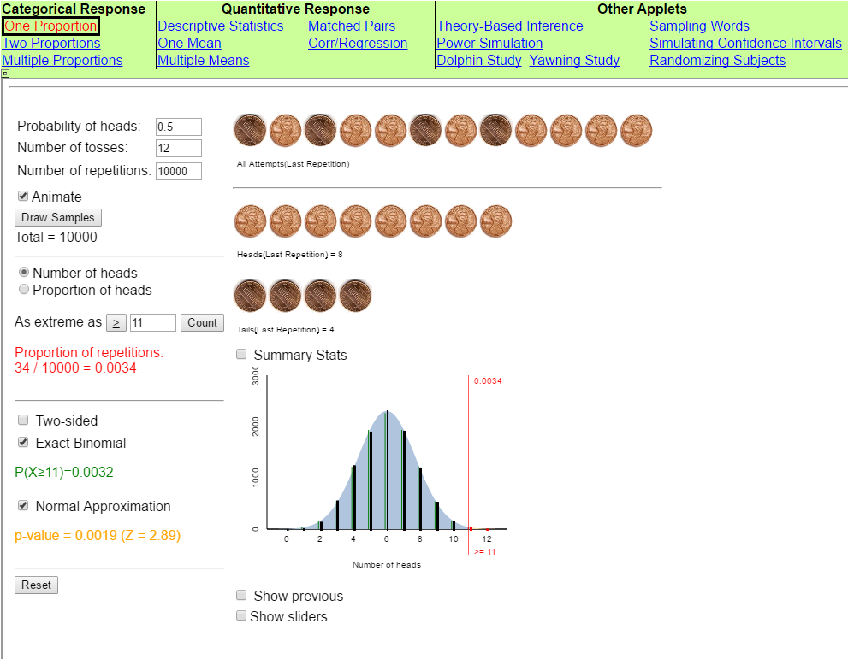
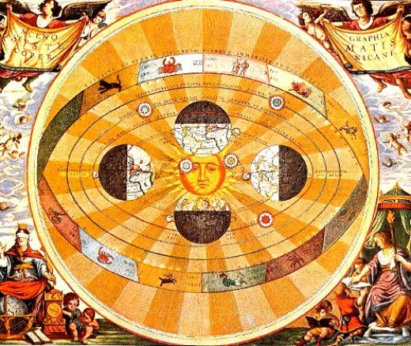
Simulation Based Inference for Learning
“Our curriculum is needlessly complicated because we put the normal distribution, as an approximate sampling distribution for the mean, at the center of the curriculum, instead of putting the core logic of inference at the center.”
George Cobb (USCOTS 2005)
Bret Rickman MS, M.Ed.
Portland Community College

Slide 2
What to Expect
Why Implement SBI as Core for Intro Stats?
Implementing SBI: Method
Tactile
Applet Simulation (Randomize, Repeat, Reject)
Theory and Excel
Implementing SBI: Successes & Challenges
Reflections and Open Discussion

Slide 3
Why do I Implement SBI as Core for Intro Stats?
The 2016 GAISE standards advise it.
Recommendation #5: Use Tech to Explore Concepts and Analyze Data.
George Cobb Article: The Introductory Statistics Course: A Ptolemaic Curriculum.
My personal experience with fundamental change.

Slide 4
2016 GAISE Report

Slide 5
George Cobb Article: The Introductory Statistics Course: A Ptolemaic Curriculum.
“We need a new curriculum, centered not on the normal distribution, but on the logic of inference.
When Copernicus threw away the old notion that the earth was at the center of the universe, and replaced it with a system that put the sun at the center, his revolution brought to power a much simpler intellectual regime.
We need to throw away the old notion that the normal approximation to a sampling distribution belongs at the center of our curriculum, and create a new curriculum whose center is the core logic of inference.
What is that core logic? I (Cobb) like to think of it as three Rs: Randomize, Repeat, Reject. “

Slide 6
George Cobb Article: The Introductory Statistics Course: A Ptolemaic Curriculum.
“Randomize data production; Repeat by simulation to see what's typical and what's not; Reject any model that puts your data in its tail.
The three Rs of inference: Randomize, Repeat, Reject
1. Randomize data production
To protect against bias
To provide a basis for inference
Random samples let you generalize to populations
Random assignment supports conclusions about cause and effect
2. Repeat by simulation to see what's typical
Randomized data production lets you re-randomize, over and over, to see which outcomes are typical, which are not.
3. Reject any model that puts your data in its tail “

Slide 7
SBI Implementation

Slide 8
SBI Implementation: Step 1 - The ‘Story’, Tactile and Applet Sims
1 Example – ‘The Woman Who Could “Smell” Parkinsons’
2 Tactile model to build distribution and check simple probability
3 Transition to Applet simulation
Randomize (produce the data)
Repeat (by simulation to see what’s typical)
Reject (any model that puts your data in its tail)
Washington Post Amazing Woman Story
Rossman / Chance Sim Applets

Slide 9
SBI Implementation: Step 2 – Math Basis & Excel
1 Present the “math” (as ‘how we did things in the old days’) with straightforward example & connection to the simulation
2 Excel example & usage with immediate student involvement. Include connection to simulation.

Slide 10
SBI Implementation
Successes & Challenges

Slide 11
SBI Implementation Successes
1 Rossman/Chance Simulators Free & Easy to Use
2 Much more straightforward to implement in our (PCC) Stats II class
3 Assessments can focus on situational items – not “how to use the tool”
Students were comfortable using the simulators

Slide 12
SBI Implementation Challenges
1 SBI is great for conceptual understanding, but doesn’t include the historical math basis.
2 SBI doesn’t as readily relate / apply to the teaching of our traditional descriptive statistics and probability rules (yet!).
3 To a certain extent, requires a computer lab – until the switch to ‘wireless device usage’ approval & implementation.
Side Note: Student feedback seemed to focus on the benefits of learning / using Excel. But students were using the simulators during exams.

Slide 13
Reflections
Fun curriculum to teach using SBI with inference as the core of the curriculum – great for conceptual student understanding.
Not enough of my classroom assessment data to evaluate effectiveness of Inference core. Is it possible that the data may not even indicate true effectiveness?
Students seem more interested and engaged with SBI curriculum than ‘traditional’ method.

Slide 14
Audience Comments & Questions
What are your thoughts on using Inference as the core element in Stats I & II curricula?
How will ‘switching’ to SBI & Inference core affect other academic departments?
What about technology use – more specifically mobile / wireless devices – in the statistics classroom?
Your thoughts and comments.

Slide 15
Helpful Links & Sources
2016 GAISE Report link: http://www.amstat.org/asa/files/pdfs/GAISE/GaiseCollege_Full.pdf
George Cobb article: The Introductory Statistics Course: A Ptolemaic
Rossman / Chance Applets: Rossman / Chance Simulation Applets Website

