Slide 1
Start Small, Dream Big: Finding Placement That Works Carolyn Hamilton Utah Valley University ORMATYC April 28, 2017

Slide 2
Utah Valley University
1941: founded as a trade technical school for war effort
1987: Utah Valley Community College (8,700 students)
1993: Utah Valley State College (12,000 students)
2008: Utah Valley University (25,000 students)
2017: Largest in Utah (35,000 students)

Slide 3
Placement Options
ACT/SAT subscores
Accuplacer
ACT/SAT + GPA
High school courses
Self-selection
Multiple measures

Slide 4
The Highest Enrolled & Highest Failed Courses
POLS1000
MATH 990
MGMT 2240
TECH1010
POLS1100
HUM1010
COMM1020
ASTR1040
PHIL205G
PSY1010
HLTH1100
HIST1700
PHIL2050
ENGL1010
MATH 1010
BIOL1010
MATH 1050
ENGL2010
25 Most Failed Courses
25 Most Highly Enrolled Courses
ZOOL2320
ZOOL2325
MUSC1010
IM1010
MATH 950
ENGH0990
SOC1010
MGMT3000
METO1010
FIN1060
PSY1100
NUTR1020
PES1097
ENGL2020

Slide 5
Two-Year Placement Expiration
Large population of students have a 2-year gap
Large non-traditional population (15-year gap)
Students’ skills do not evaporate after a set amount of time
If not refreshed, learning curve too steep
Student skills can be refreshed quickly

Slide 6
Math at UVU
Two Math Departments in separate Colleges
Student skills vary wildly in every class
70% of incoming students need remediation

Slide 7
Curriculum Creep
Intermediate Algebra
College Algebra

Slide 8
Curriculum Creep
Intermediate Algebra
College Algebra

Slide 9
Curriculum Creep
Intermediate Algebra
College Algebra

Slide 10
Curriculum Creep
Beginning Algebra
Intermediate Algebra
College Algebra

Slide 11
Curriculum Creep
Beginning Algebra
Intermediate Algebra
College Algebra

Slide 12
Curriculum Creep
Beginning Algebra
Intermediate Algebra
College Algebra

Slide 13
Accordion Curriculum
MAT 920 Arithmetic (3.0)
MAT 950 Pre-algebra (4.0)
MAT 990 Beginning Algebra (4.0)
MAT 1010 Intermediate Algebra (4.0)
MAT 980 (5.0)
}
}
MAT 1000 (5.0)

Slide 14
What We Had Tried

Slide 15
Summer Bridge Program 2013-2015
Courses | Initial Student Placement | Final Student Placement
 | 99 | Arith | Pre alg | Beg alg | Int alg | Coll alg
Arithmetic | 13 | 4 | 6 | 0 | 3
Pre algebra | 22 |  | 5 | 13 | 4
Beg algebra | 23 |  |  | 6 | 17
Int algebra | 41 |  |  |  | 40 | 1

Slide 16
Summer Bridge Program 2013-2015
Courses | Initial Student Placement | Final Student Placement
 | 99 | Arith | Pre alg | Beg alg | Int alg | Coll alg
Arithmetic | 13 | 4 | 6 | 0 | 3
Pre algebra | 22 |  | 5 | 13 | 4
Beg algebra | 23 |  |  | 6 | 17
Int algebra | 41 |  |  |  | 40 | 1

Slide 17
Summer Bridge Program 2013-2015
Courses | Initial Student Placement | Final Student Placement
 | 99 | Arith | Pre alg | Beg alg | Int alg | Coll alg
Arithmetic | 13 | 4 | 6 | 0 | 3
Pre algebra | 22 |  | 5 | 13 | 4
Beg algebra | 23 |  |  | 6 | 17
Int algebra | 41 |  |  |  | 40 | 1
Pass Rate:
50%

Slide 18
Summer Bridge Program
Unequal Benefit
Dubious Success Rate
Why no college algebra?
Cut Score?

Slide 19
Intermediate/College Algebra Combo Pilot
How to measure success?
Accuplacer given to all students during first week of course and again during last week of course in order to measure learning outcomes

Slide 20
Intermediate/College Algebra Combo Pilot

Slide 21
Intermediate/College Algebra Combo Pilot
Line of No Change

Slide 22
MATH 1010/1050 Combo Pilot
Lessons Learned:
Accuplacer has little correlation at any level.
Change in cut score is not the solution.

Slide 23
Summer 2015 ALEKS Pilot
6 weeks in ALEKS course product for $38
3 weeks with an instructor (2 hours per day)
Comprehensive Knowledge Assessment used for placement

Slide 24
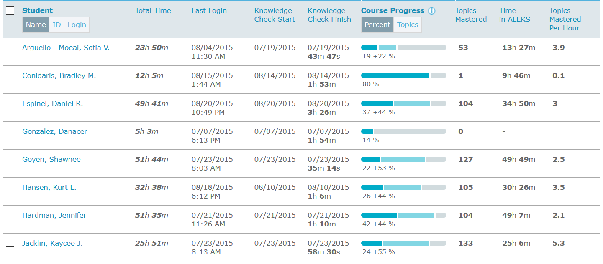
Summer 2015 ALEKS Pilot

Slide 25
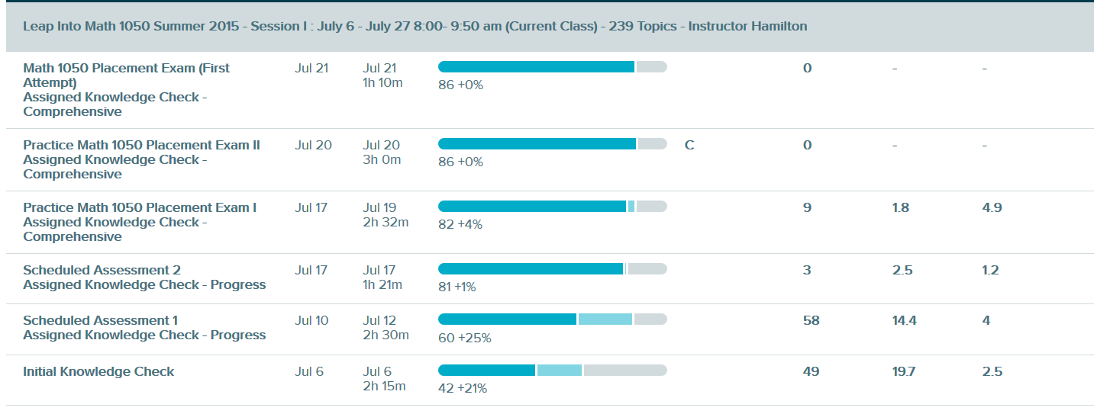
Summer 2015 ALEKS Pilot

Slide 26
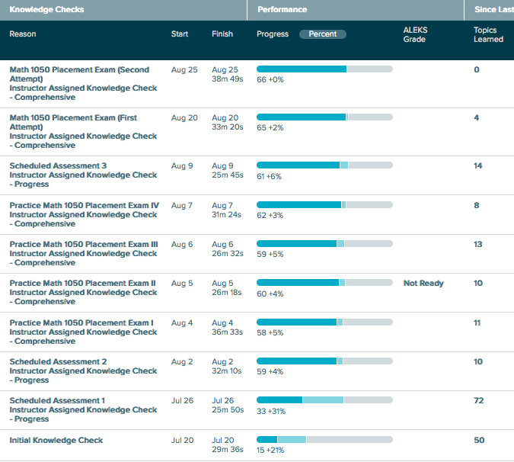
Consistent

Slide 27
Summer 2015 ALEKS Pilot
Lessons Learned:
Assessment with ALEKS is consistent

Slide 28
Summer 2015 ALEKS Pilot
Initial Student Placement | Courses | Final Placement
50 |  | Int Alg | College Alg
50 | Int alg | 26 | 24

Slide 29
Summer 2015 ALEKS Pilot
Initial Student Placement | Courses | Final Placement
50 |  | Int Alg | College Alg
50 | Int alg | 26 | 24
48% of students were able to place into college algebra using ALEKS placement
Successful in next course?

Slide 30
Summer 2015 ALEKS Pilot
80% of the students placed into college algebra by ALEKS passed
Average grade: B
n is too small for significance
Likely placed too low to begin with

Slide 31
Students are making measurable progress
Won’t work for truly developmental students

Slide 32
Spring 2016 QL Completion Pilot
Identified students who had stopped out without completing degree
All graduation requirements met except Quantitative Literacy (QL)
Met minimum GPA requirements
ALEKS PPL pre- and post-tests

Slide 33
Spring 2016 QL Completion Pilot
Initial Student Placement | Courses | Final Student Placement
39 |  | Pre Alg | Beg Alg | Int Alg | Coll Alg
9 | Pre Alg | 2 | 2 | 2 | 3
15 | Beg Alg |  | 7 | 4 | 4
10 | Int Alg |  |  | 1 | 9
5 | Coll Alg |  |  |  | 5

Slide 34
Spring 2016 QL Completion Pilot
Initial Student Placement | Courses | Final Student Placement
39 |  | Pre Alg | Beg Alg | Int Alg | Coll Alg
9 | Pre Alg | 2 | 2 | 2 | 3
15 | Beg Alg |  | 7 | 4 | 4
10 | Int Alg |  |  | 1 | 9
5 | Coll Alg |  |  |  | 5

Slide 35
Spring 2016 QL Completion Pilot
Initial Student Placement | Courses | Final Student Placement
39 |  | Pre Alg | Beg Alg | Int Alg | Coll Alg
9 | Pre Alg | 2 | 2 | 2 | 3
15 | Beg Alg |  | 7 | 4 | 4
10 | Int Alg |  |  | 1 | 9
5 | Coll Alg |  |  |  | 5

Slide 36
Spring 2016 QL Completion Pilot
ALEKS can help even the most underprepared prepared students advance if they are motivated

Slide 37
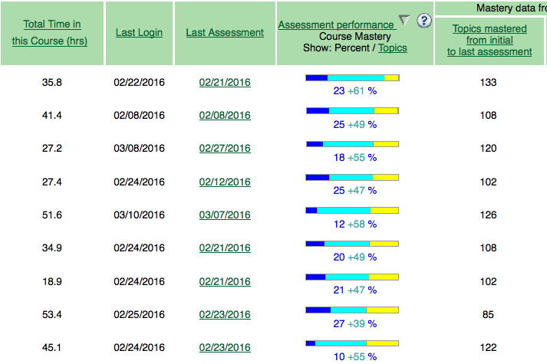

Slide 38
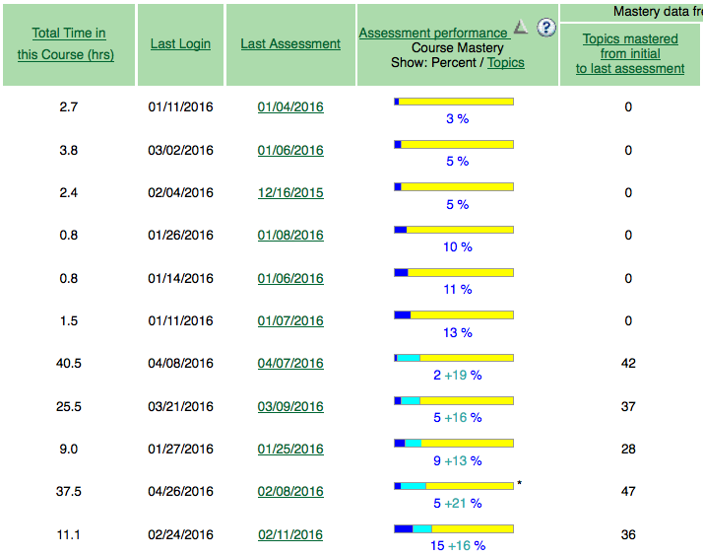

Slide 39
Lesson Learned:
ALEKS is multiple measures:
Mathematical knowledge
Initiative
Work ethic

Slide 40
Wasatch High Pilot Spring 2016

Slide 41
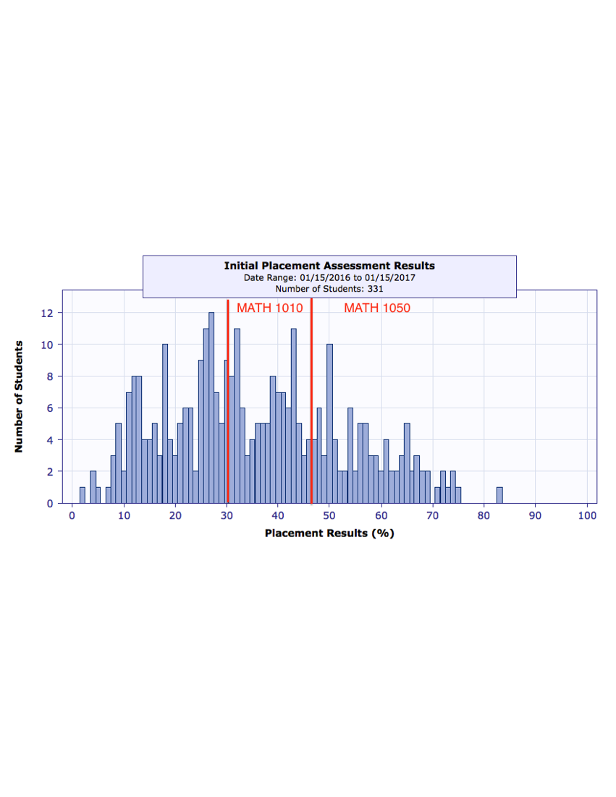
Wasatch High Pilot
N = 331

Slide 42
Wasatch High Pilot Spring 2016
N = 167

Slide 43
Wasatch High Pilot Spring 2016
N = 167

Slide 44
Wasatch High Pilot
Lessons Learned:
Not all SM3 students are created equal
No one placed lower on a retake with ALEKS

Slide 45
Predictable Placement

Slide 46
Better Placement
More accurate placement
More homogenous classes
Higher pass rates
Potential to inform curriculum
Seamless transition from high school to college
Opportunity to improve placement level
Transparency means less frustration
Less wasted time and money
Less anxiety about math placement across campus

Slide 47
What is ALEKS?
Assessment and LEarning in Knowledge Spaces
What’s a knowledge space?
Intricate mathematical data structure of prerequisite knowledge chains

Slide 48
Knowledge Spaces
$$10=\frac{3(x−3)}{2}+\frac{5x−8}{4}$$
$$x=6$$
Distributive Property, Least Common Denominator, combining similar terms, adding positive and negative numbers, dividing two numbers, balancing an equation, multiplying fractions, multiplying positive and negative numbers, cancelation property of fractions

Slide 49
{a, c, i, g, h}
Unknown
Known
{a, g, h, i}
{c, i, g, h}
{g, h, i}
{c, g, h}
{c, i, g}
{c, i, h}
{g, h}
{i, g}
{c, g}
{i, h}
{c, i}
{g}
{i}
{c}
{ }
Notes:
After the initial assessment. In this case, a student is in a state where have mastered topics. G, H, I. Because on the initial assessment, they demonstrated this, we can infer that everything below the state g, h, I is also known to the student.

Slide 50
{a, c, i, g, h}
Unknown
Known
{a, g, h, i}
{c, i, g, h}
{g, h, i}
{c, g, h}
{c, i, g}
{c, i, h}
{g, h}
{i, g}
{c, g}
{i, h}
{c, i}
{g}
{i}
{c}
{ }
Notes:
These are the subsets of the knowledge state which means the student “knows” these items as well.

Slide 51
{a, c, i, g, h}
Unknown
Known
Ready to Learn
{a, g, h, i}
{c, i, g, h}
{g, h, i}
{c, g, h}
{c, i, g}
{c, i, h}
{g, h}
{i, g}
{c, g}
{i, h}
{c, i}
{g}
{i}
{c}
{ }
Notes:
Because a student knows g,h,i,; they’re also ready to learn topic c.

Slide 52
{a, c, i, g, h}
Unknown
Known
Ready to Learn
{a, g, h, i}
{c, i, g, h}
{g, h, i}
{c, g, h}
{c, i, g}
{c, i, h}
{g, h}
{i, g}
{c, g}
{i, h}
{c, i}
{g}
{i}
{c}
{ }
Notes:
Or you can go here. Note, you are just adding {a}.

Slide 53
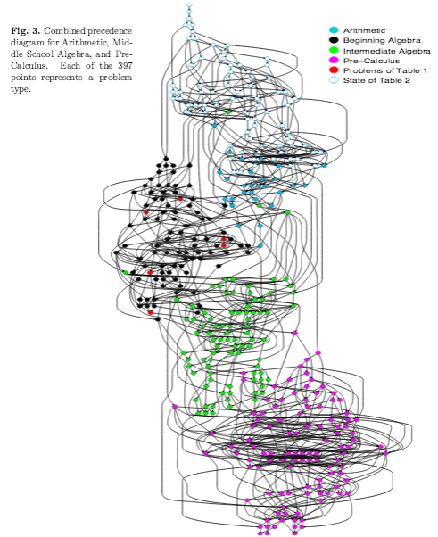

Slide 55
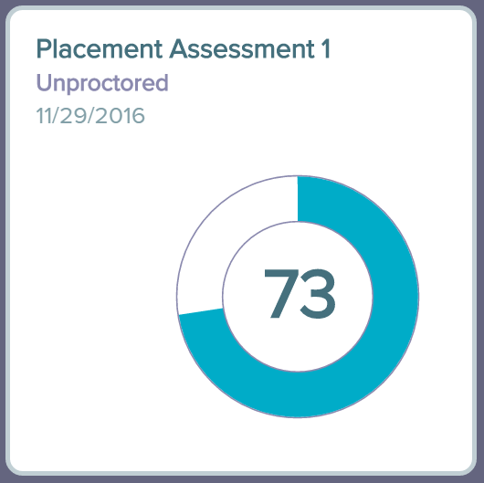
Lessons Learned
Assessments need to be proctored

Slide 56
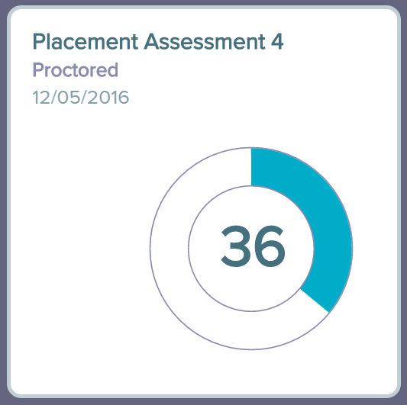
Lessons Learned
Assessments need to be proctored

Slide 57
Lessons Learned
Proctored Placement

Slide 58
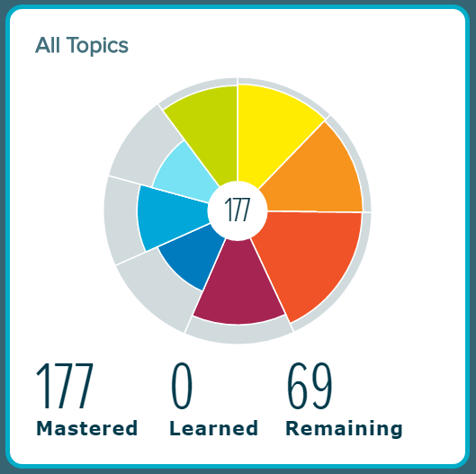
Lessons Learned
Proctored Placement

Slide 59
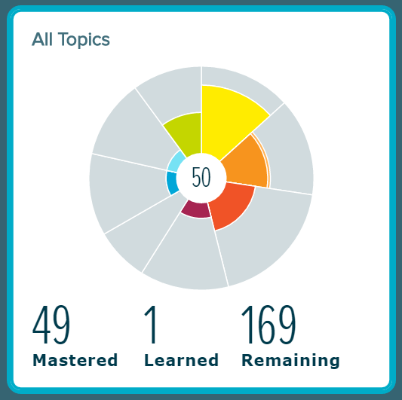
Lessons Learned
Proctored Placement

Slide 60
Lessons Learned
Proctored Placement

Slide 61
Student Messaging
“Be honest or you may be placed in a higher course and possibly fail”
Don’t ruin your study plan! You’ll be forced into a higher learning module and review material won’t be available before your retake.

Slide 62
Savings from Improved Placement based on Fall 2016 enrollments
Fewer Courses Needed: 50% of students skip at least one math course with ALEKS
50% of 3,574 in dev math = 1,787 fewer students
= 60 sections of 30 students
Fewer Courses Repeated: 80% pass rate means 808 students that won’t need repeat a math class
= 27 sections of 30 students

Slide 63
After One Year…
Senior Academic Vice President is convinced
Math faculty are convinced
Advisors are (mostly) convinced but worried
High-level Student Affairs (mostly) convinced but worried
Developmental math faculty are resigned
Accuplacer contract expiring Fall 2017

Slide 64
How to Implement?
Find: Accuplacer
Replace: ALEKS PPL

Slide 65
Fundamental Questions
Who pays?
Proctored or unproctored?
When to place?
Guided study? Emporium? Self-study?
Who is in charge?

Slide 66
When to place?
Approach placement as a process, not an event
Placement required for admission?
Freshman Orientation
Expiration of placement scores?
“Just-in-time” placement

Slide 67
What We Did
Placement no longer required before admissions
3rd week structured enrollment decision
Placement not part of Orientation

Slide 68
Guided study?

Slide 69
Guided study?
50% of students started a Prep Module working independently

Slide 70
Guided study?
84% of students started a Prep Module working with a faculty member

Slide 71
MATH 100R Math Leap
Meets for 2 hours once each week with full-time faculty member for 7 ½ weeks
Proctored placement on first and last day
Math help, advising and ALEKS guidance
Minimum hours per week in ALEKS required
Non-credit and 1.0 credit options

Slide 72
MATH 100R Math Leap
Average of 1.1 courses skipped per student
Initial: 70% test Beginning Algebra or lower
Final: 75% test Intermediate Algebra or higher

Slide 73
Who is in charge?
Academic department sets policies, guidelines, deadlines, etc.
Who is responsible?
Implementation done by IT, Registrar, Admissions, Advising, Testing Services, High School Coordination, Orientation

Slide 74
Key Areas to Consider
Placement Product
Data analysis
IT implementation
Campus communication
hotline, website, emails
Support Services
Labs, TAs, proctoring

Slide 75
Tiffany
Data collection & outcomes reporting
Colleen
Testing Center
Carolyn
Academic Coordinator
Andrew
Recruitment & Admissions
Proctoring
Concurrent Enrollment
Advising
Student Retention
Admissions
IT Coordination
Marketing
Registration
ALEKS Cohorts
Faculty liaison
Math Leap
Math Lab Tutoring

Slide 76
Lessons Learned
Changing attitude and beliefs takes time
Many, many meetings
“One more barrier”
Majority of work done by Student Affairs
Respect their workload
IT for ALEKS has been easy
IT for Banner processes takes more time

Slide 77
Hurdles to Clear
Strong tradition of ACT/SAT placement
Multiple placements in ALEKS
Too expensive
Textbook publisher’s product
Admissions policy requires placement
State contract with Accuplacer
Multiple measures are needed

Slide 78
Accordion Curriculum
MAT 920 Arithmetic (3.0)
MAT 950 Pre-algebra (4.0)
MAT 990 Beginning Algebra (4.0)
MAT 1010 Intermediate Algebra (4.0)
MAT 980 (5.0)
}
}
MAT 1000 (5.0)

Slide 79
Accordion Curriculum
MAT 920 Arithmetic (3.0)
MAT 950 Pre-algebra (4.0)
MAT 990 Beginning Algebra (4.0)
MAT 1010 Intermediate Algebra (4.0)
MAT 950 (4.0)

Slide 80
Accordion Curriculum
MAT 920 Arithmetic (3.0)
MAT 950 Pre-algebra (4.0)
MAT 990 Beginning Algebra (4.0)
MAT 1010 Intermediate Algebra (4.0)
MAT 950 (4.0)
MAT 1000 (4.0)

Slide 81
Accordion Curriculum
MAT 920 Arithmetic (3.0)
MAT 950 Pre-algebra (4.0)
MAT 990 Beginning Algebra (4.0)
MAT 1010 Intermediate Algebra (4.0)
MAT 950 (4.0)
MAT 1000 (4.0)
GE Math (3 options)

Slide 82
Pathway – Quantitative Reasoning

Slide 83
Pathway – College Algebra

Slide 84
ALEKS Testimonials

Slide 85
Long Journey Disruptive Worth the Work

Slide 86
Questions

