Slide 1
Putting the Fundamental Back into the Fundamental Theorem of Calculus
Tenchita Alzaga Elizondo and Brittney Ellis
Portland State University

Slide 2
Worksheet
Once you get a copy of the handout, privately think about the image and the questions being asked
Private think time (2 min)
Group Share (5 min)
How did your thoughts and answers differ to those of your neighbors?
Discussion

Slide 3
Worksheet

Slide 4
Discussion
What were the main ideas behind this activity?
Rate of change at a moment
A moment, while a function’s independent quantity varies, is a tiny variation of values around a specific value of the independent quantity (Thompson, 2016)
Emphasizes the idea of having an essentially constant rate of change in a moment
Giving meaning to differentials (dD and dt)
A differential is a variable quantity that represents values of a variable that vary “a little bit”

Slide 5
Rate of Change at a Moment
We define rate of change at a moment by the following:
“A function has a rate of change at the moment x₀ if, over a suitably small interval of its independent variable containing x₀, the function’s value changes at essentially a constant rate with respect to its independent variable” (Thompson, 2016)

Slide 6
Giving Meaning to Differentials

Slide 7
The Two Big Ideas of Calculus
You know how much of a quantity there is at every moment; you want to know how fast it is changing at every moment
You know how fast a quantity changes at every moment; you want to know how much of it there is at every moment

Slide 8
Restructuring Calc 1
Timeline | Traditional version | Adapted version
Week 1-4 | Limits, continuity, definition of a derivative | Functions, covariation, rate of change at a moment, applications of rate of change
Week 4-8 | Differentiation techniques, related rates, implicit differentiation | Rate of change function and different rules for finding exact rate of change functions, applications (throughout)
Week 8-10 | Applications of derivatives | Limits, L’Hopital’s rule, continuity, and formalizations

Slide 9
Restructuring Calc 2
Timeline | Traditional version | Adapted version
Week 1-4 | Definite and indefinite integrals, the FTC, area under a curve | Functions, covariation, derivative review with Taylor polynomials, accumulation from rate of change, applications (throughout)
Week 4-8 | Integration techniques, improper integrals, numerical integration | FTC, integration techniques, numerical integration, applications (throughout)
Week 8-10 | Applications of integrals, Taylor polynomials, arc length | Formalization, improper integrals, and more applications

Slide 10
Moving Away from Geometry
Action View | Process View
A function is tied to a specific rule, formula, or computation and requires the completion of specific computations and/or steps (Functions as Static) | A function is a generalized input-output process that defines a mapping of a set of input values (Functions as Dynamic)
A function’s graph is a geometric figure | A function’s graph defines a specific mapping of a set of input values to a set of output values
We are staying away from slope, tangent lines, area under a curve, etc. since it encourages an action view
Table from Oehrtman, Carlson, & Thompson (2008)

Slide 11
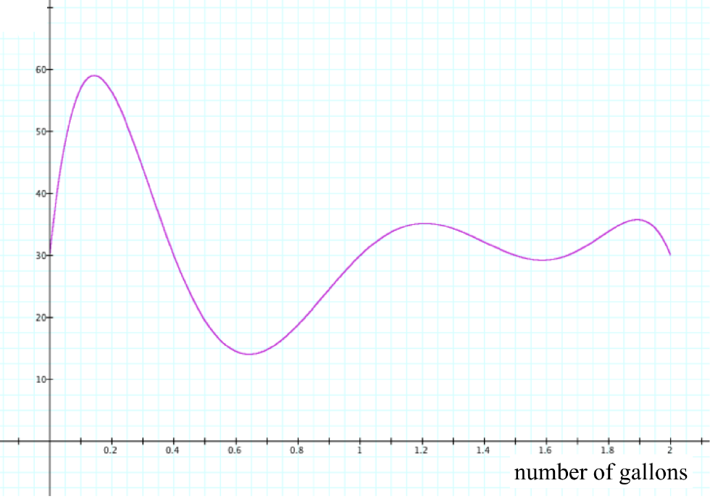
Accumulation
Once you have a worksheet, take a look at the graph of the function
Private think (2 min)
Pair (5 min)
Discussion
Fuel efficiency

Slide 12
Discussion
The graph that you have tells us the rate at which the distance is varying at every moment (the rate of change)
The questions you answered told us how much of that quantity there is at every moment
The function describing these values is called an accumulation function
Student contributions from a calc 2 class
“How efficient your ‘miles per gallon’ in a gallon moment?”
“Why don’t we get exact answers?”
“How do you interpret the point (0, 30)?”

Slide 13
Active Calculus OER
Key adaptations to the Active Calculus (Boelkins, Austin, & Schlicker, 2017) OER:
Introduces limits, continuity, and differentiability after properties and applications of rate of change functions
Introduce first and second order rate of change function early
Introduces optimization application early (modification of AC desmos optimization activity)
Chain rule introduced before product or quotient rules
Supporting understanding of function composition
Quotient rule is an application of the chain rule and product rule
L’Hopital’s Rule emphasized as motivation for limits

Slide 14
Active Calculus OER
Key adaptations to the Active Calculus (Boelkins, Austin, & Schlicker, 2017) OER:
Begin with Taylor polynomials as review of derivatives and approximation functions
Introduces integrals as accumulation functions rather than as “area under the curve”
Building up the notion of an approximate rate of change function as a step function
Only include left-endpoint approximations until end of course
After FTC, follows AC for computation, using substitution, by parts, etc.
“Area under curve” treated as an application

Slide 15
Active Calculus OER
Key adaptations to the Active Calculus (Boelkins, Austin, & Schlicker, 2017) OER:
Modifying WeBwork problems from Active Calculus to incorporate into MyOpenMath
Switching to Knewton next year
Improve student interface, feedback
Improve instructor interface, feedback

Slide 16
Thank you!
References and acknowledgements
Project DIRACC: http://patthompson.net/ThompsonCalc/About.html
Boelkins, M. R., Austin, D., & Schlicker, S. (2017). Active calculus, 2017 edition. Allendale: Orthogonal Publishing L3C.
Oehrtman, M., Carlson, M., & Thompson, P. W. (2008). Foundational reasoning abilities that promote coherence in students’ function understanding. Making the Connection: Research and Practice in Undergraduate Mathematics.
Thanks to the awesome team at PSU - Steve Boyce, Ann Sitomer, Joanna Bartlo, and Rachel Webb!
If you have any questions or comments please email us at halzaga@pdx.edu (Tenchita) or bme3@pdx.edu (Brittney)

