Slide 1
Improving
Conceptual Understanding in Intro Stats
Patti Frazer Lock Kari Lock Morgan
Dept of Math, CS, and Stats Department of Statistics
St. Lawrence University Penn State University
ORMATYC
April, 2018

Slide 2

The Lock⁵ Team
Kari
[Harvard]
Penn State
Eric
[North Carolina]
Minnesota
Dennis
[Iowa State]
Miami Dolphins
Patti & Robin
St. Lawrence

Slide 3
Intro Stats is rapidly increasing in importance.
How can we improve this course?
Improving student understanding
Improving success rates
Reducing prerequisites
Reducing reliance on algebra and formulas
Increasing student interest and retention
Increasing faculty enjoyment

Slide 4
How can we do this?
Using
Simulation Methods
to
increase understanding
reduce prerequisites
Increase student success

Slide 5
How can we do this?
Keynote Address tomorrow!
“The Future of Intro Stats”
Addressing broad changes and outcomes
Today’s Session:
Hands-on workshop on using simulation
methods and other materials to improve the Intro Stats course

Slide 6
A Simulation Approach to
Hypothesis Tests

Slide 7
Example #1: Light at Night
Question: Does having a light on at night increase weight gain?
(in mice)
Experiment:
10 mice had a light on at night
8 mice had darkness at night
Randomly assigned!
Weight gain (in grams) was recorded after three weeks.¹
¹ Fonken, L., et. al., “Light at night increases body mass by shifting time of food intake, ” Proceedings of the National Academy of Sciences, 2010; 107(43).

Slide 8
Light at Night
Body Mass Gain (grams)
Light
1.71
4.67
4.99
5.33
5.43
6.94
7.15
9.17
10.26
11.67
Dark
2.27
2.53
2.83
4.0
4.21
4.6
5.95
6.52
Light mean = 6.73
Dark mean
= 4.11
Light mean – Dark mean = 2.62
Does light at night actually increase body mass gain or is the difference just due to random chance?

Slide 9
Light at Night
Body Mass Gain (grams)
What kinds of results would we see, just by random chance, if there were no effect from light at night?
Light
1.71
4.67
4.99
5.33
5.43
6.94
7.15
9.17
10.26
11.67
Dark
2.27
2.53
2.83
4.0
4.21
4.6
5.95
6.52

Slide 10
Light at Night
Body mass gain (grams)
What kinds of results would we see, just by random chance, if there were no effect from light at night?
Light
1.71
4.67
4.99
5.33
5.43
6.94
7.15
9.17
10.26
11.67
Dark
2.27
2.53
2.83
4.0
4.21
4.6
5.95
6.52
1.71 2.27 2.53 2.83
4.00 4.21 4.60 4.99
5.33 5.43 5.95 6.52
6.94 7.15 9.17 10.26
11.67
We can find out!! Just re-randomize the 18 values into one pile of 10 and one of 8, simulating the original random assignment.

Slide 11
Light at Night
Body mass gain (grams)
What kinds of results would we see, just by random chance, if there were no effect from light at night?
Light
Dark
2.53 2.83
4.00 4.21 4.60 4.67 4.99 5.33 5.43 5.95 6.52 6.94 7.15 9.17 10.26 11.67
1.71
2.27
2.53
4.00
4.21
4.67
5.43
6.52
6.94
9.17
11.67
2.83
4.60
4.99
5.33
5.95
7.15
10.26
Compute the light mean minus dark mean of this simulated sample.
Do this thousands of times!

Slide 12
We need technology!!
STATKEY!
www.lock5stat.com/statkey
Free, online, works on all platforms, easy to use!

Slide 13
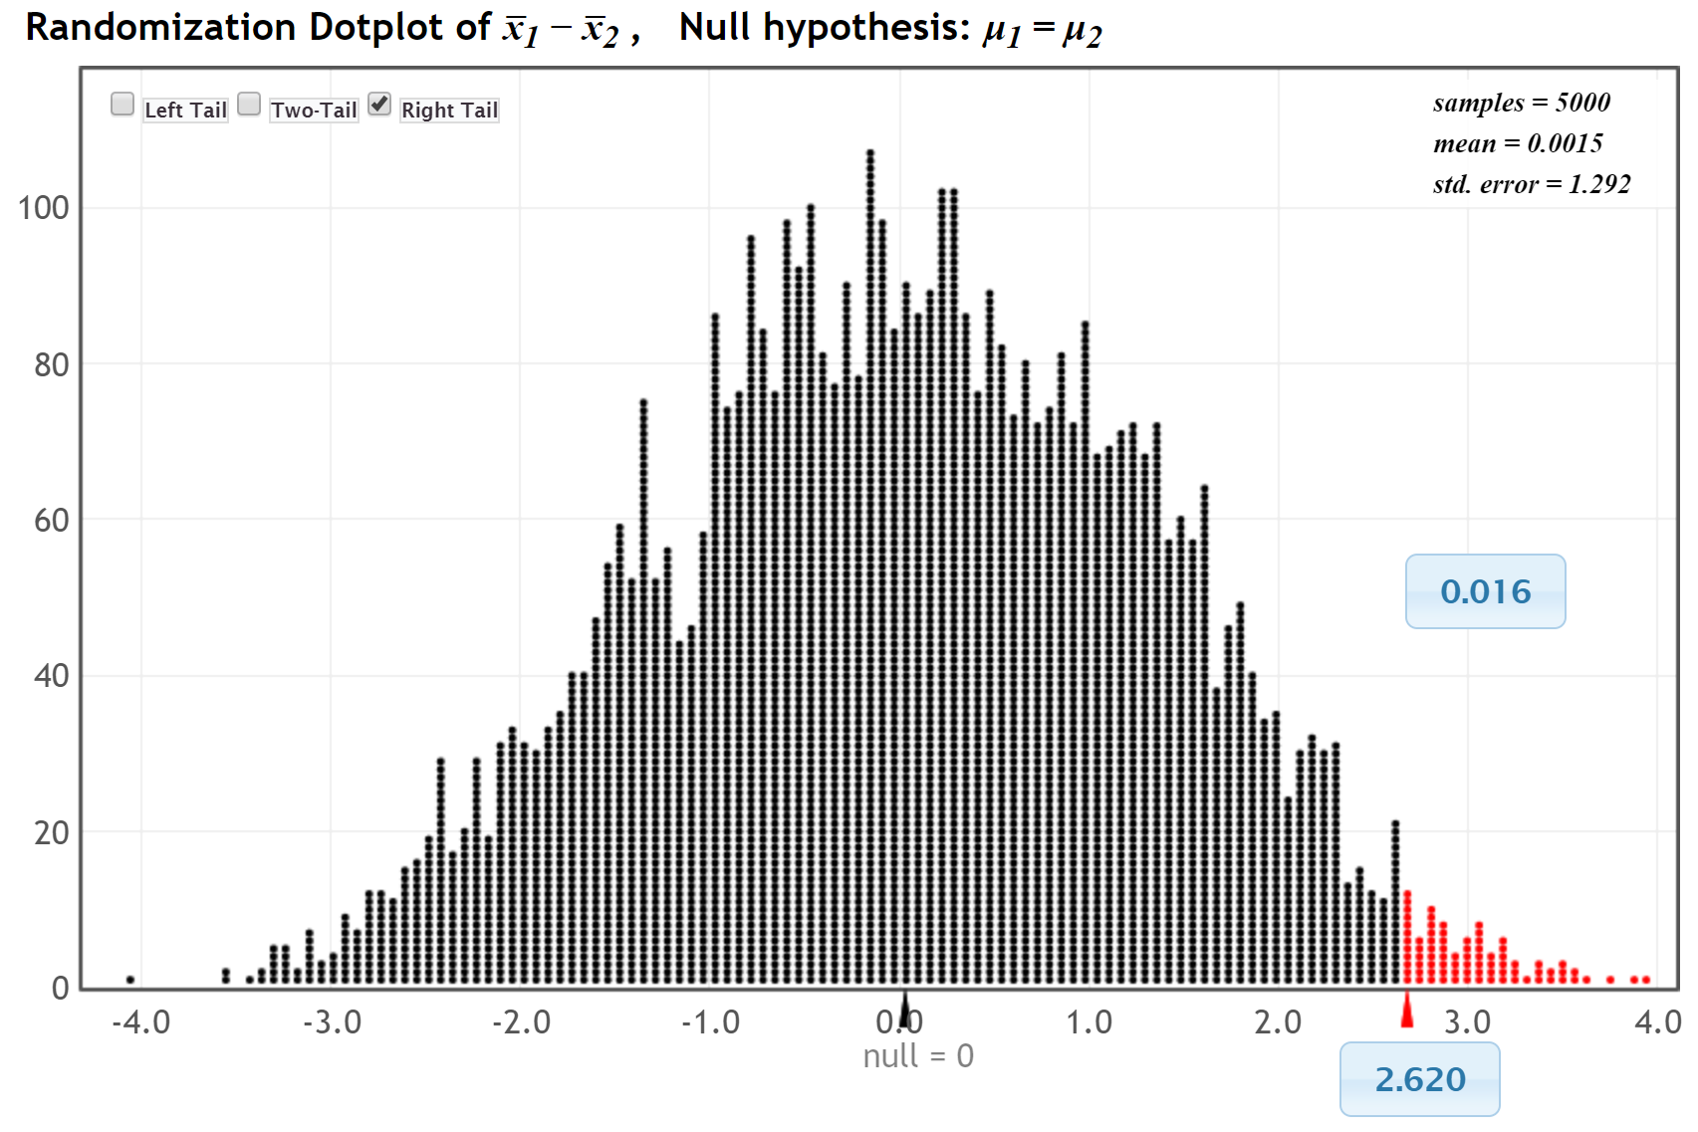
P-value
This is what we are likely to see just by random chance if light at night doesn’t matter.
This is what we saw in the experiment.

Slide 14
Light at Night
The Conclusion!
The difference of 2.62 is unlikely to happen just by random chance.
We have evidence that having a light on at night does increase weight gain. (at least in mice)

Slide 15
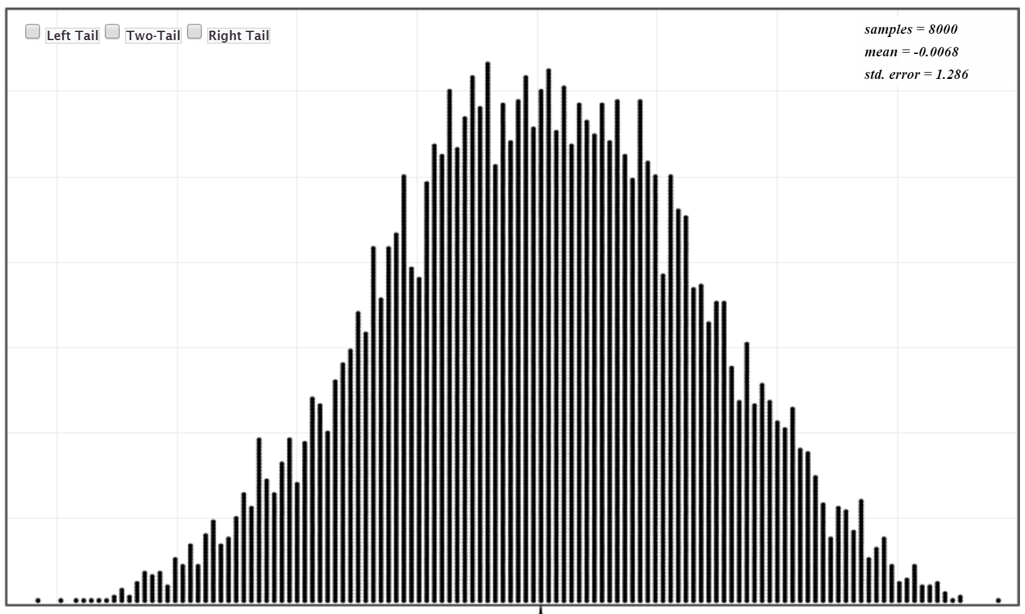
Randomization distribution:
Shows what is likely just due to random variation in the data
Sample statistic way out here:
Not just random variation!
There is evidence for the effect!

Slide 16
Randomization distribution:
Shows what is likely just due to random variation in the data
Sample statistic here:
Could be just random variation.
Not enough evidence to make a clear conclusion.

Slide 17
Randomization Hypothesis Tests
Similar process for all parameters! Enables big picture understanding
Reinforces key concept of random variation
Ties directly (and visually) to understanding key concept of strength of evidence
Helps understanding of p-value: How extreme are sample results if null hypothesis is true?
Very visual!
Low emphasis on algebra and formulas!
Improves student understanding AND student success rates (See Keynote Address tomorrow!)
The way of the future!! (See Keynote Address tomorrow!)

Slide 18
Example #2: A Yes/No Question!
Audience participation! What Yes/No question do you want to ask this group?
Question: Is the proportion of people who would say “Yes” to this question different than 0.5?
Hypothesis test for a proportion.

Slide 19
Example #3: Malevolent Uniforms
Do sports teams with more “malevolent” uniforms get penalized more often?

Slide 20
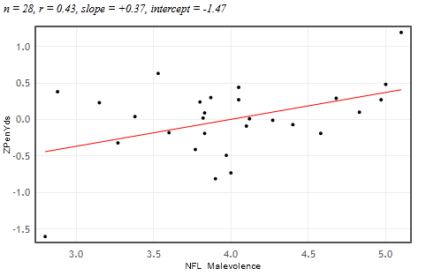


Example #3: Malevolent Uniforms
Sample Correlation
= 0.43
Do teams with more malevolent uniforms commit more penalties, or is the relationship just due to random chance?

Slide 21
Example #3: Malevolent Uniforms
Hypothesis test for correlation. Sample statistic is r = 0.43.
www.lock5stat.com/statkey
From the Main Menu, under Randomization Hypothesis Test:
Select “Test for Slope, Correlation”
Find the “Malevolent Uniforms” data (it is the default)
Note the Original Sample. Find the sample correlation, r = 0.43.
(Generate 1 Sample. What is the correlation for this simulated sample? Find the corresponding dot on the randomization distribution.)
Generate a randomization distribution (1000 or more).
Use the “right-tail” option, and enter the sample correlation in the lower blue box.
What is the p-value?

Slide 22
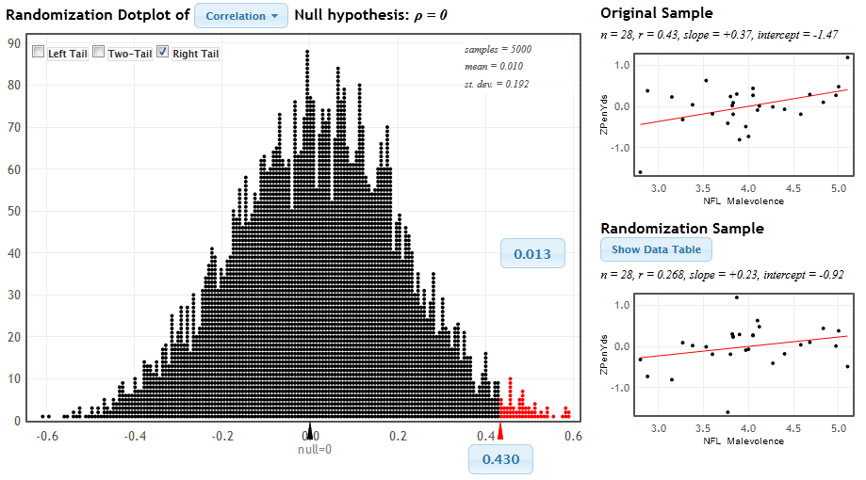
StatKey
www.lock5stat.com/statkey
P-value

Slide 23
Malevolent Uniforms
The Conclusion!
The results seen in the study are unlikely to happen just by random chance (just about 1 out of 100).
We have some evidence that teams with more malevolent uniforms get more penalties.

Slide 24

Example 4: Split or Steal?
http://www.youtube.com/watch?v=p3Uos2fzIJ0
 | Split | Steal | Total
Under 40 | 187 | 195 | 382
Over 40 | 116 | 76 | 192
Total | 303 | 271 | n=574
Van den Assem, M., Van Dolder, D., and Thaler, R., “Split or Steal? Cooperative Behavior When the Stakes Are Large,” 2/19/11.
Notes:
Watch the video… pause before the results, and ask students what they would do

Slide 25
Example 4: Split or Steal?
www.lock5stat.com/statkey
From the Main Menu, under Randomization Hypothesis Test:
Select “Test for Difference in Proportions”
Use the “Edit Data” button to put in values:
Group 1 (under 40): Count = 187, Sample Size = 382
Group 2 (over 40): Count = 116, Sample Size = 192
Note the Original Sample. What are the two sample proportions? What is the difference in proportions? Which group is more likely to “split”?
Generate a randomization distribution (1000 or more).
Use the “two-tail” option, and enter the sample difference in proportions in the lower blue box.
What is the p-value?

Slide 26
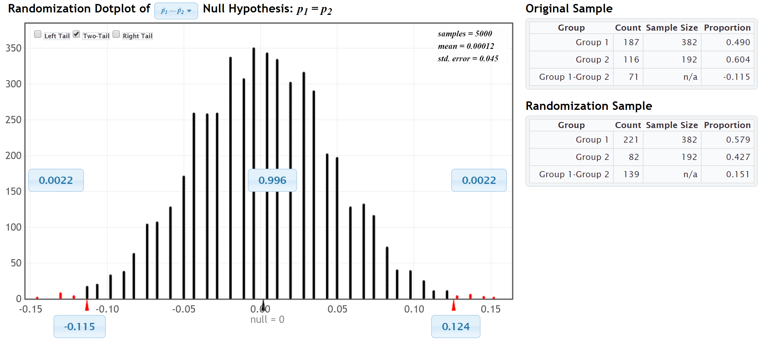
StatKey
www.lock5stat.com/statkey
P-value
P-value = 2(0.0022) = 0.0044

Slide 27
Split or Steal
The Conclusion!
The results seen in the study are very unlikely to happen just by random chance (less than 5 out of 1000).
We have strong evidence that older people are more likely to choose the nice option (split).

Slide 28
Moving beyond Hypothesis Tests:
Additional ways to
“Improve conceptual understanding
in Intro Stat”

Slide 29
Additional Resources
www.lock5stat.com
Statkey
Free!
Easy-to-use!
Google App (Don’t need internet)
Lots of additional resources for Intro Stats!

Slide 30
www.lock5stat.com
plock@stlawu.edu
klm47@psu.edu

