Slide 1
Math Outside the Box
MATH
The true heartbeat of mathematics is finding solutions to interesting questions

Slide 2
Math 60 question I fielded in recitation Friday: Find an expression for the statement: 12 less than the quotient of a number cubed and 8.
HOW CAN WE EXPECT STUDENTS TO INVEST ENERGY IN OUR SUBJECT WITH SUCH UNINSPIRING PROBLEMS?

Slide 3
The true heartbeat of mathematics is finding solutions to interesting questions
Math Outside the Box:
Can we find one day in an 11 week term to show students an interesting question that justifies learning our powerful language?
How can you pull a kayak off a rock?

Slide 4
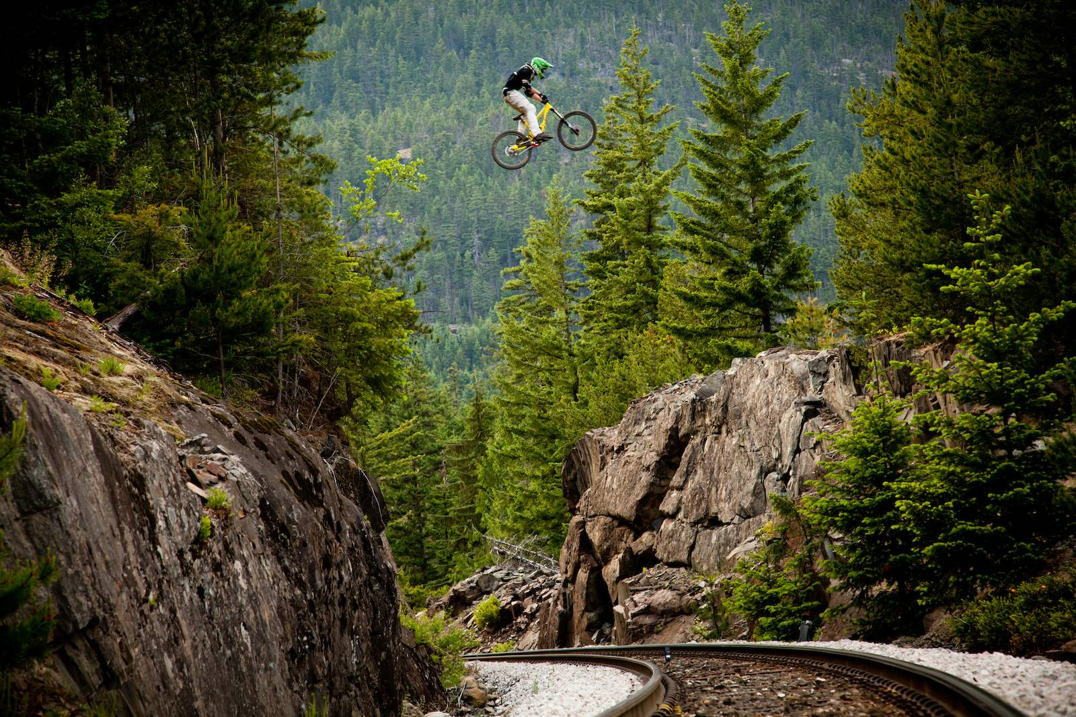
How Fast Should I Pedal? … Train Gap Jump at Whistler
https://vimeo.com/43881693

Slide 5
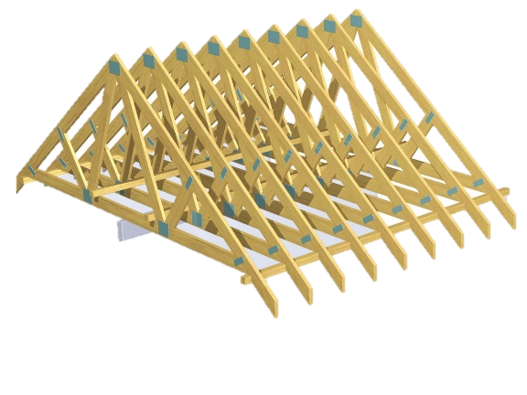
Interesting problems build bridges for our students between the REAL WORLD and often ABSTRACT WORLD of algebra

Slide 6
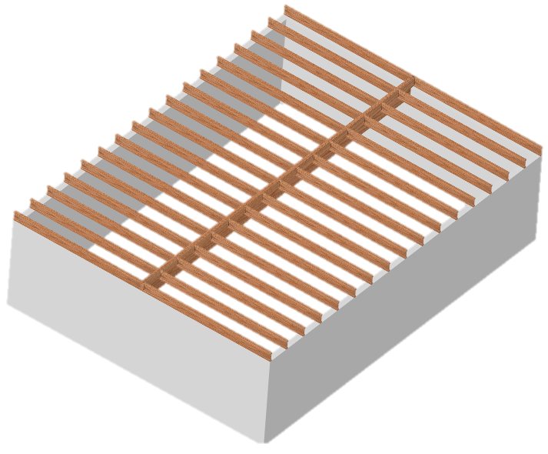
Interesting Question for Today: What dimension 32ft-long beam would be required to support a 24ft x 32ft floor?
What are the relevant considerations?
Let’s try a 3-1/2” x 20” VLB

Slide 7
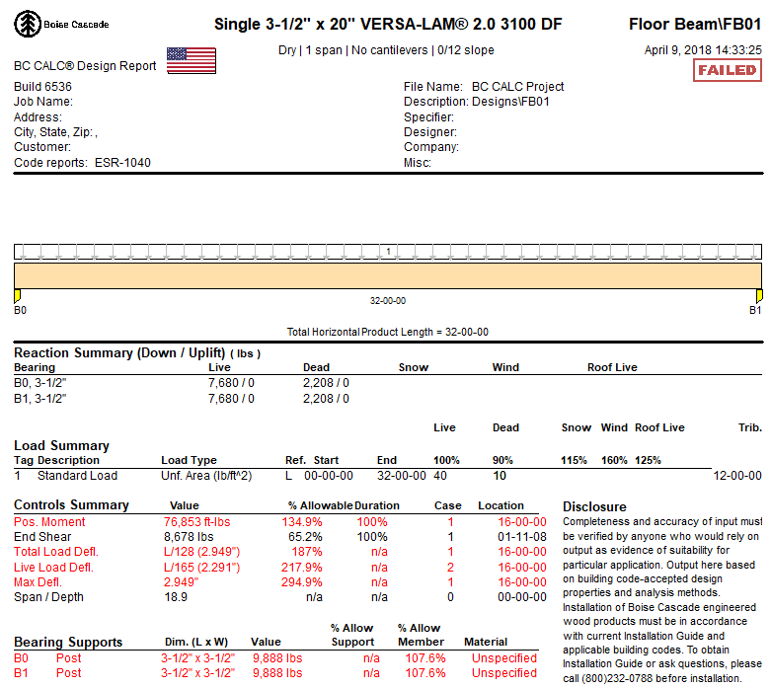
BC CALC
Shows that our beam fails in deflection … and moment but passes in shear

Slide 8
Consider a 32’ long floor beam with 12’ of tributary. Tributary is the width the beam is responsible to carry
•Residential floor load is 50 lbs/ft² •A 3-1/2” x 20” VLB adds18 lbs/ft
•How many pounds per lineal foot (PLF) will our beam need to carry?

Slide 9
Our 3-1/2” x 20” VLB is 32’ long with 12’ of tributary
• Residential floor load is
50 lbs/ft² • Our beam needs to able to carry 12ft x 50 lbs/ft² = 600 lbs/ft of floor load +18 lbs/ft = 618PLF

Slide 10
How much will it bend (deflect) under this load and does that matter?
1st Consideration: Deflection

Slide 11
Calculate the Deflection $D=\frac{5wL^{4}}{384EI}$ … an utterly amazing relationship courtesy of differential equations. D = deflection (in) w = weight on the beam (lbs/in) L = length of the beam (in) E = elasticity of the beam (lbs/in² or PSI) … VLB’s have an E-value of 2,000,000 PSI I = moment of inertia of the beam (in⁴) $I=\frac{bd^{3}}{12}$ ; b is the width and d is the depth of the beam … formula courtesy of integral calculus!

Slide 12
$$D=\frac{5wL^{4}}{384EI}$$ $$I=\frac{3.5in∙{\left(20in\right)}^{3}}{12}≈2333{in}^{4}$$ $$D=\frac{5∙51.5\frac{lbs}{in}∙{\left(384in\right)}^{4}}{384∙2000000\frac{lbs}{{in}^{2}} ∙2333{in}^{4}} ≈3.12in$$ maximum deflection is 1 inch

Slide 13
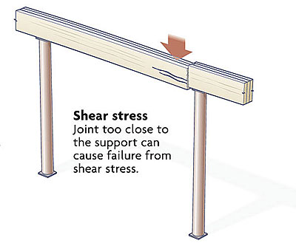
How much VERTICAL force is on the beam at the wall that could crush it?
2nd Consideration: Shear

Slide 14
Can you see why the walls must push up with 9888 lbs of force?

Slide 15
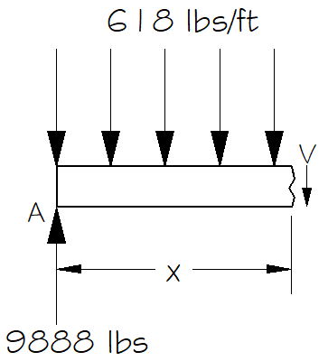
A beam is capable of resisting a certain amount of shear depending on its dimensions
Find a formula for the shear (V) force at any point on the beam x-ft away from the left side
* Note: the sum of all the vertical forces must be 0 to maintain static equilibrium
9888 – 618x - V = 0
Shear Formula: V = 9888 – 618x

Slide 16
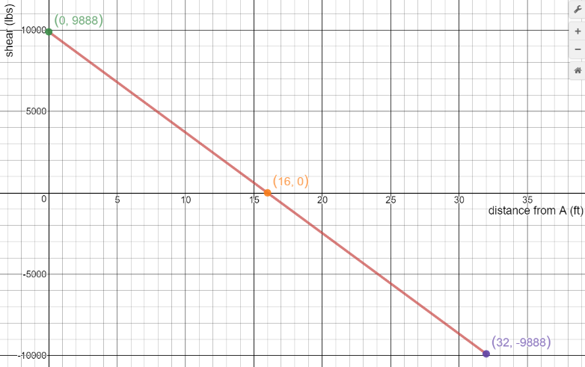
Shear Diagram: maximum shear is the issue … 9888 lbs

Slide 17
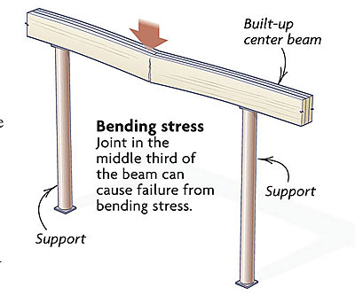
How much TORQUE (F•d) is on the beam at the center that could snap it?
3rd Consideration: Moment

Slide 18
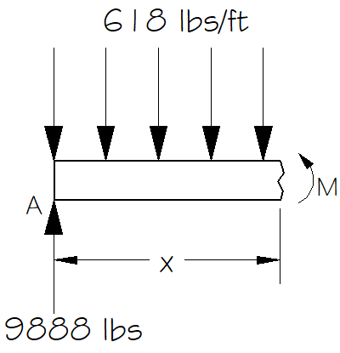
A beam is capable of resisting a certain amount of moment depending on its dimensions
Find a formula for the moment (M) around any point on the beam x-ft away from the left side
* Note: the sum of all the moments must be 0 to maintain static equilibrium
9888x – 618x•0.5x - M = 0
Moment Formula: M = 9888x – 309x²

Slide 19
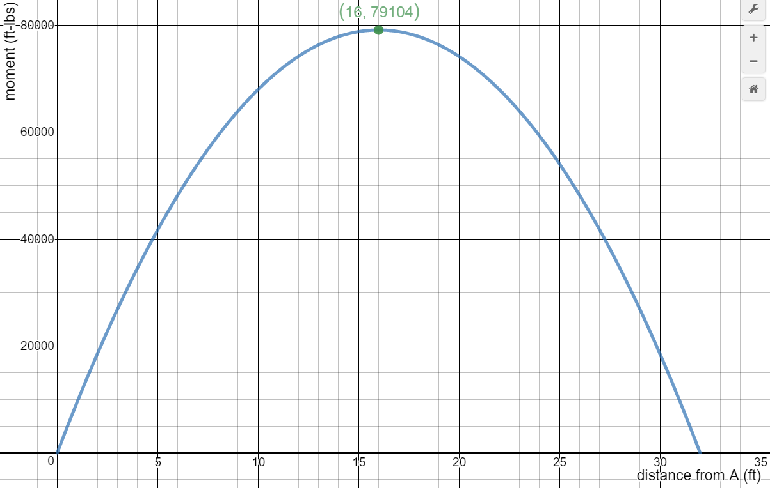
Moment Diagram: maximum moment is the issue .. 79,104 ft-lbs

Slide 20
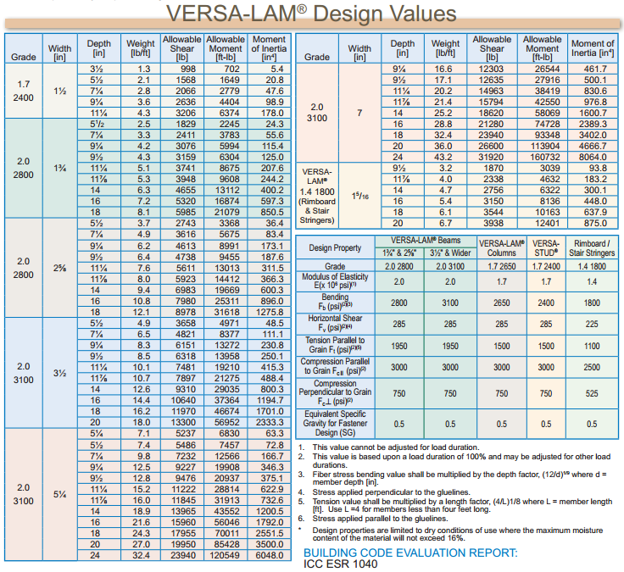

Slide 21
Our design requires:
Shear = 9888 lbs
Moment = 79,104 ft-lbs
So it fails the moment requirement

Slide 22
But a 5-1/4” x 20” VLB would suffice:
Shear = 9888 lbs
Moment = 79,104 ft-lbs

Slide 23
$$D=\frac{5wL^{4}}{384EI}$$ $$I=\frac{5.25in∙{\left(20in\right)}^{3}}{12}=3500{in}^{4}$$ $$D=\frac{5∙52.25\frac{lbs}{in}∙{\left(384in\right)}^{4}}{384∙2000000\frac{lbs}{{in}^{2}} ∙3500{in}^{4}} ≈2.11in$$ still fails in deflection … exceeding 1in

Slide 24
Will one of these satisfy the deflection requirement?
$$D=\frac{5wL^{4}}{384EI}$$

Slide 25
The coolest Part: What do you notice about the relationship between these 2 equations? V = 9888 – 618x M = 9888x – 309x²

Slide 26
Something every calculus instructor should see: the units for the area under this curve would be ft-lbs … ∫V = M

Slide 27
Consider for a moment the shear volume of math concepts, from nearly every course we offer, that we have needed to understand how weight affects a stick:
•Area
•Unit analysis
•Operations with decimals and fractions
•Order of operations
•Why formulas matter
•Creating and solving equations
•Purpose of a variable
•How to graph lines and parabolas
•The purpose graphs can serve
•Finding the maximum on a parabola
•x & y intercepts
•Percentages
•The importance of paying attention to units
•Reading information from a chart
What if we took 1 day in math 60 and showed them what they could do if they stayed with it?

Slide 28
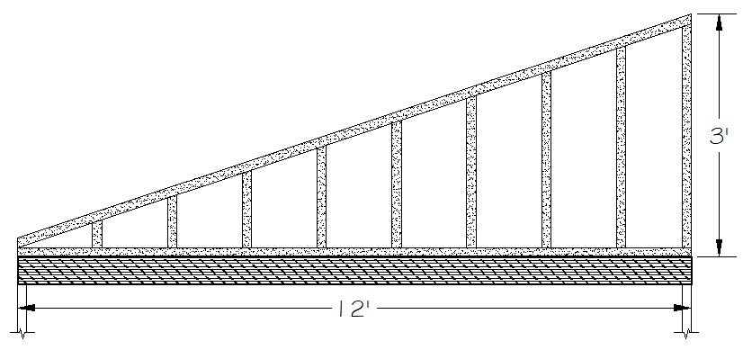
A continuous but linearly increasing load, such as a rake wall would produce, presents a more interesting case:

Slide 29
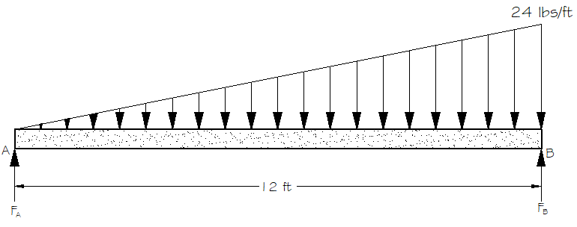
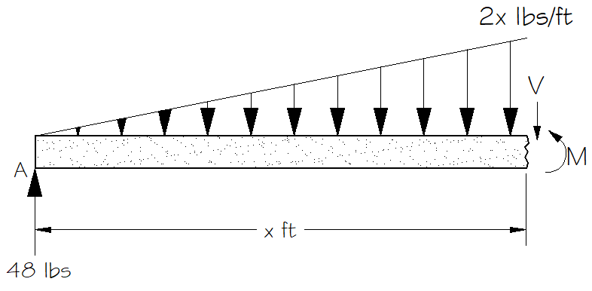
Load: w = –2x

Slide 30
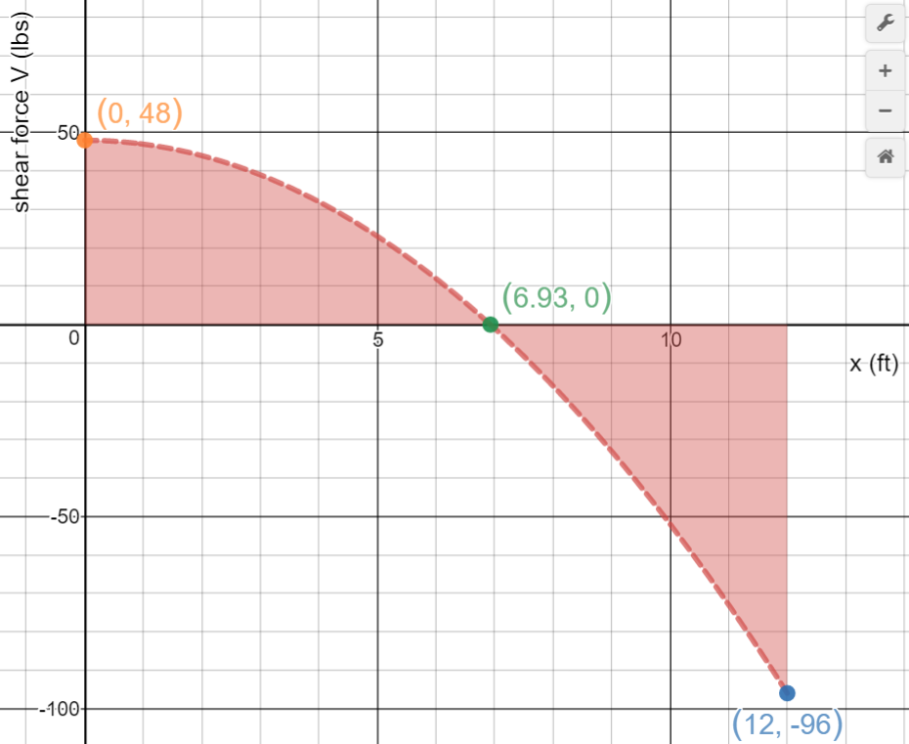
Shear: V = 48 – x² Note the intercept at x = 6.93

Slide 31
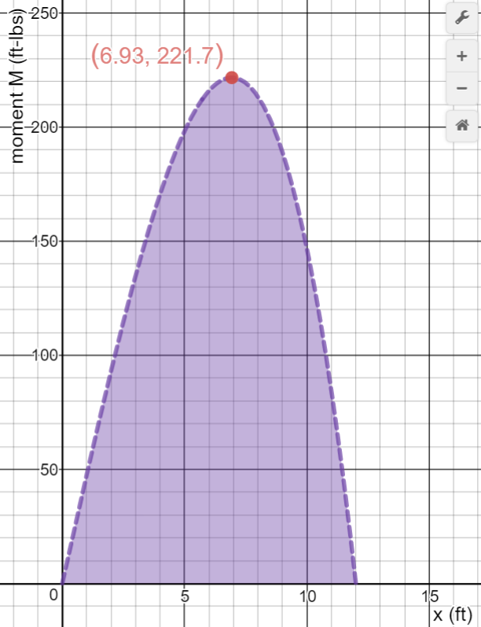
Moment: M = 48x – $\frac{1}{3}$x³ Note the maximum moment occurs at the point of zero shear

Slide 32
More Math Outside the Box Problems at: http://go.roguecc.edu/user/dgardner/math-outside-box
Doug Gardner – RCC
dgardner@roguecc.edu

