Slide 1
Using EdPuzzle in a Flipped Classroom
EdPuzzle is the perfect tool for allowing students to watch and engage with videos while the teacher gathers data throughout the lesson. As teachers dabble into the flipped classroom philosophy, EdPuzzle is the perfect enhancement tool for videos to be watched at home instead of eating up valuable class time.
Bret Rickman MS, M.Ed.
Portland Community College

Slide 2
What to Expect
Why use Edpuzzle to Manage Video Content?
Implementing EdPuzzle – The “Test Drive” Segment
Questions and Comments

Slide 3
Why use EdPuzzle?
Other video management systems available, but EdPuzzle has a free option (up to 20 videos).
Relatively straight-forward start up.
Nice student accountability features:
Prevents fast-forwarding (toggled)
Quick check on student / class progress
Easily embed questions into videos

Slide 4
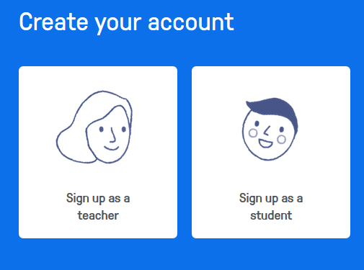
Implementing EdPuzzle – Signing Up (Teacher)
Notes:
Will take awhile to do this. Need to get here quickly to allow plenty of time!

Slide 5
Creating Lessons

Slide 6
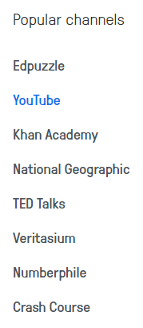
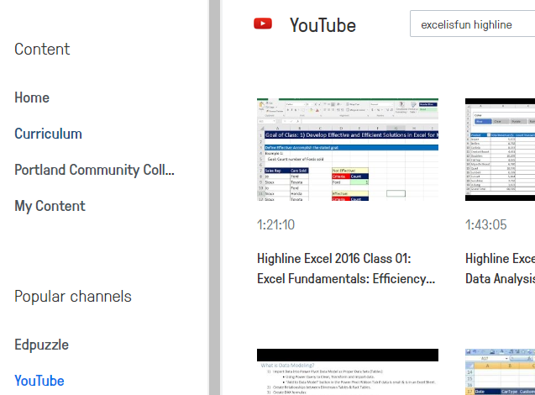
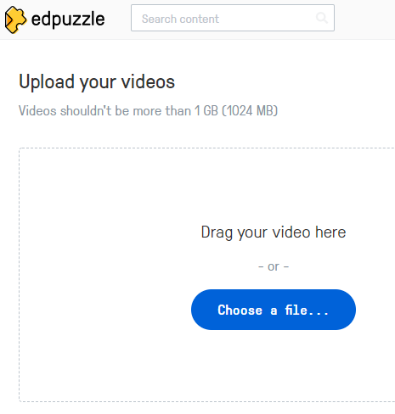
Implementing EdPuzzle – Creating Lessons
Notes:
Have attendees upload a YouTube video like ExcelisFun. “YouTube” Channel, “Search” -> “ExcelIsFun”, etc. Then press the “copy / duplicate” button on video thumbnail.

Slide 7
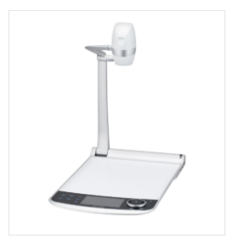
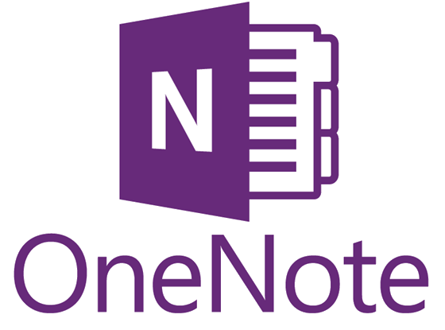
Implementing EdPuzzle – Creating Lessons
Creating your own videos – Many options!
Edpuzzle acceptable formats: MP4, MOV, AVI
Under 1 Gb

Slide 8
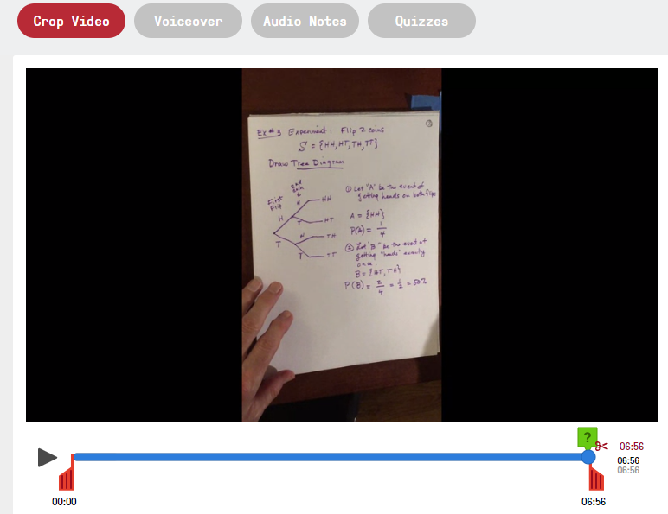
Implementing EdPuzzle – Creating Lessons
Notes:
Demo “Cropping” a video.
Audio Note is short audio – especially if using someone else’s video. Voiceover is a duration of the video audio recording.

Slide 9
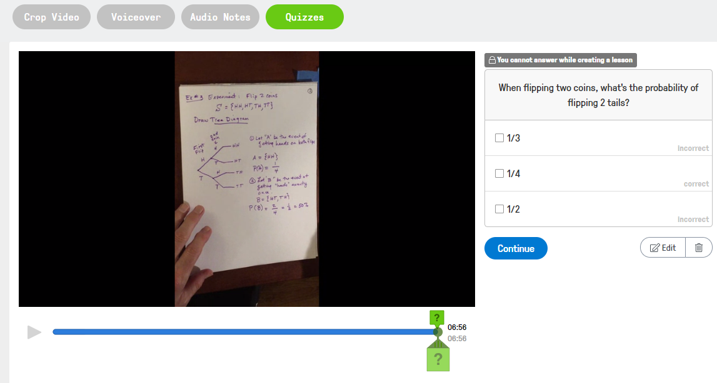
Implementing EdPuzzle – Creating Lessons
Notes:
Demo and have attendees create a question to embed.

Slide 10
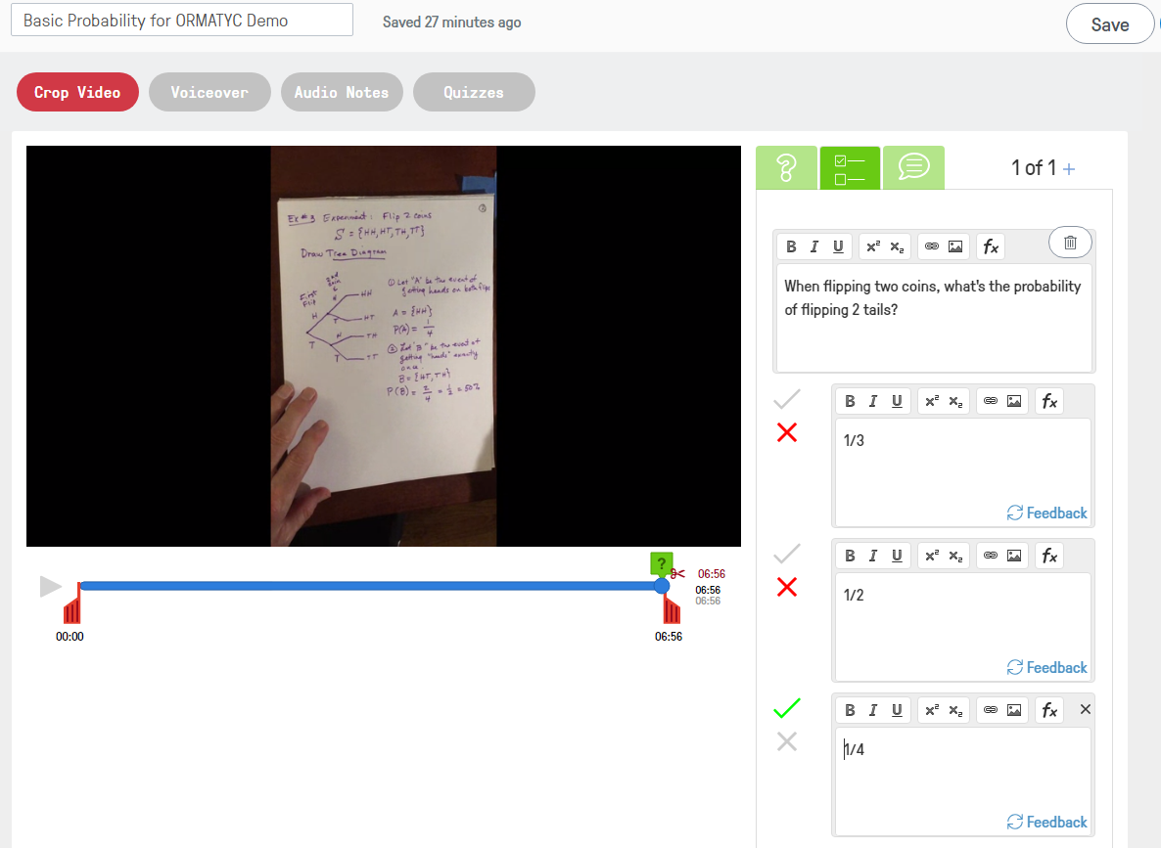
Implementing EdPuzzle – Creating Lessons
Answers with feedback!
Notes:
Demo steps in creating an embedded question with “Basic Probability for ORMATYC” and then have attendees create one question (with feedback).

Slide 11
Creating Classes
Notes:
Will take awhile to do this. Need to get here quickly to allow plenty of time!

Slide 12
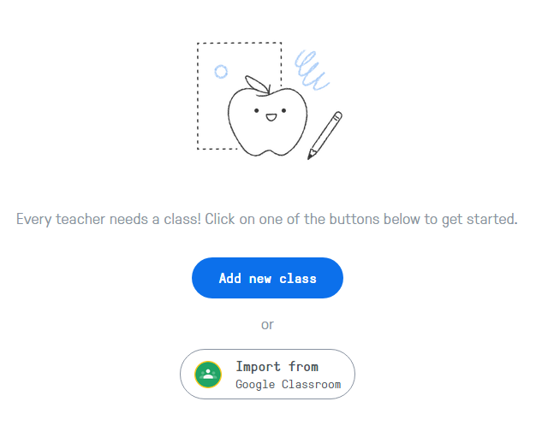
Implementing EdPuzzle – Create a Class
Notes:
Attendees can do this! Just won’t have students yet!

Slide 13
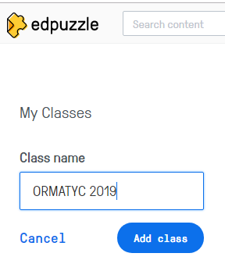
Implementing EdPuzzle – Create a Class
Notes:
Attendees can do this! Just won’t have students yet!

Slide 14
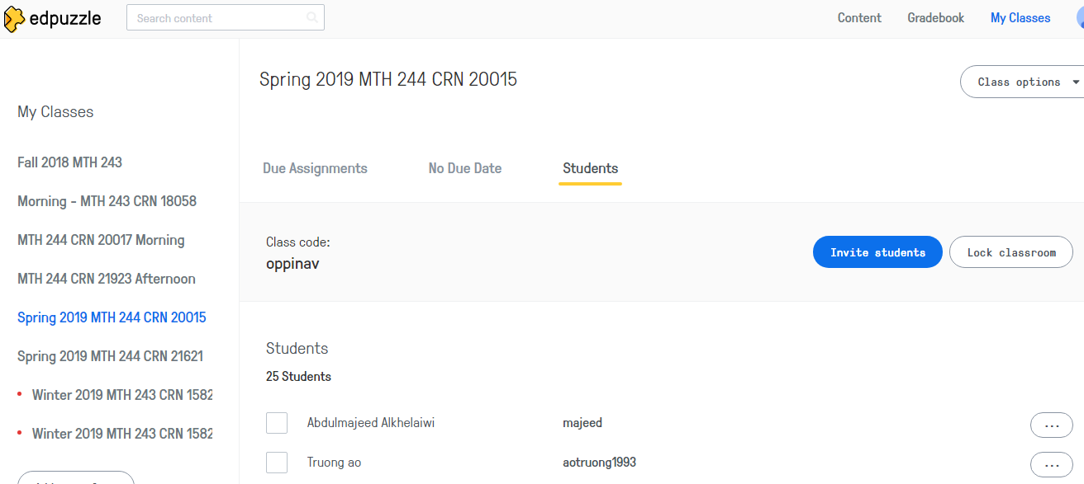
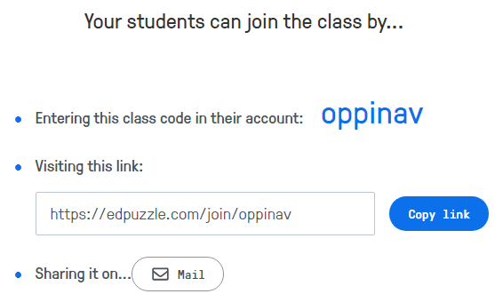
Implementing EdPuzzle – “Inviting” Students
Edit Name
Delete Class
Edit Name
Reset Password
Remove from Class
Notes:
Attendees can do this!

Slide 15
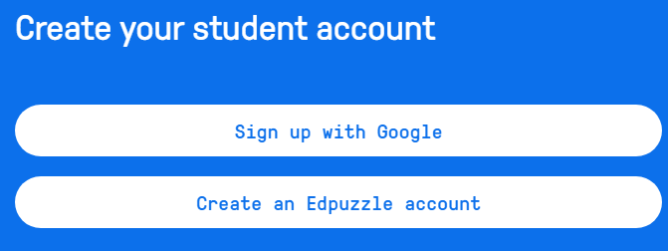
Implementing EdPuzzle – Students Sign Up
Notes:
Attendees can do this! Just won’t have students yet!

Slide 16
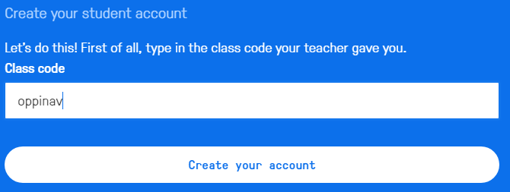
Implementing EdPuzzle – Students Sign Up
Notes:
Attendees can do this! Just won’t have students yet!

Slide 17
Assigning Lessons & Checking Student Progress

Slide 18
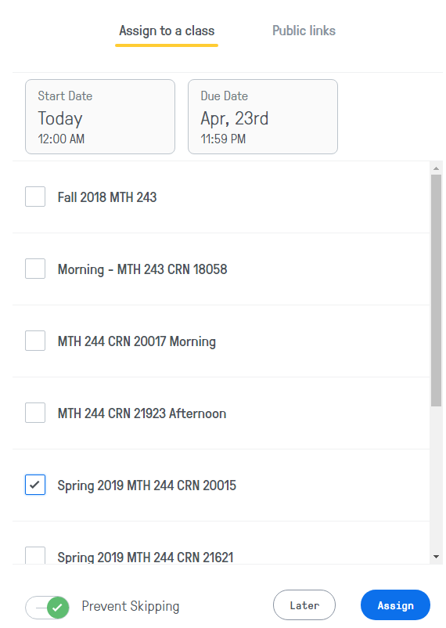
Implementing EdPuzzle – Assigning Video Lessons
Notes:
Won’t be able to do this until a “class” is created. I will demo with my ‘PCC’ EdPuzzle account though and attendees can do this as well!

Slide 19
Implementing EdPuzzle – Checking Student Progress
Quick Check on Class Progress
Notes:
Won’t be able to do this until a “class” is created. Use my ‘PCC’ account to demonstrate.

Slide 20
Implementing EdPuzzle – Checking Student Progress
Individual Progress
Turned “On” by default
Embedded Questions
Notes:
Won’t be able to do this until a “class” is created. Use my ‘PCC’ EdP account to demo.

Slide 21
Managing Video Content

Slide 22
Implementing EdPuzzle – Managing Content
Create Video
Upload Video
Student Project
Add Folder
Notes:
Could demo creating a folder and adding content, if needed or desired.

Slide 23
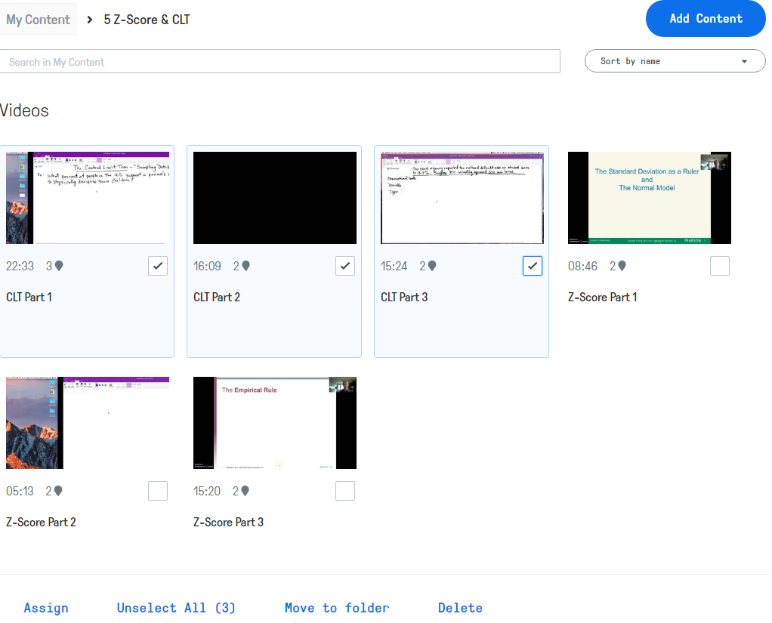
Implementing EdPuzzle – Managing Content
Edit Video
View Video
Duplicate Video
Notes:
Could demo Duplicating Video and discuss a use of this if needed or desired.

Slide 24
Now you’re ready to start creating video content for your students! Any Questions or Comments?

Slide 25
Helpful Links
Edpuzzle Website: https://edpuzzle.com
Camtasia Website: https://www.techsmith.com/video-editor.html
Screencast-o-matic: https://screencast-o-matic.com/
MS OneNote: https://www.onenote.com

