Slide 1
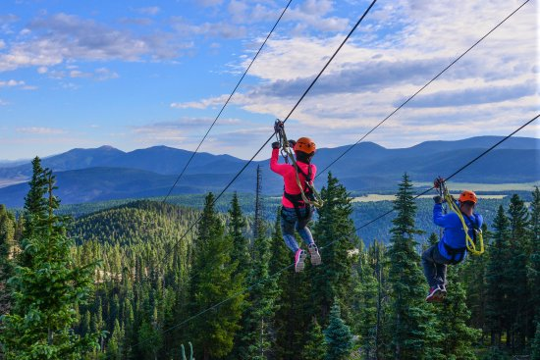
How to slide down a cable from high to low … and arrive at the end, neither too fast nor too slow!
Designing a zip-line
Doug Gardner – RCC

Slide 2
“If I had to design a mechanism for the express purpose of destroying a child’s natural curiosity … I couldn’t possibly do as good a job as is currently being done … in contemporary mathematics education. (pg. 20)
“You don’t start with definitions, you start with problems … nobody ever thought of irrational numbers until Pythagoras attempted to find the diagonal of a square.”(pg. 79)

Slide 3
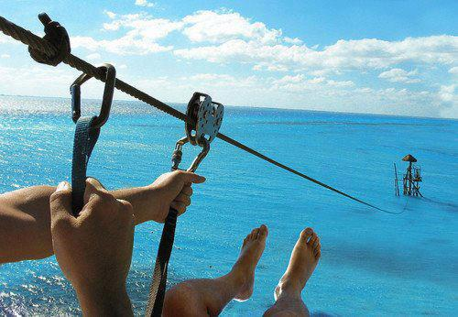
I HOPE SOMEONE THOUGHT THIS THROUGH
Not sure about this LZ

Slide 4
1960 Essay: The Unreasonable Effectiveness of Mathematics in the Natural Sciences

Slide 5
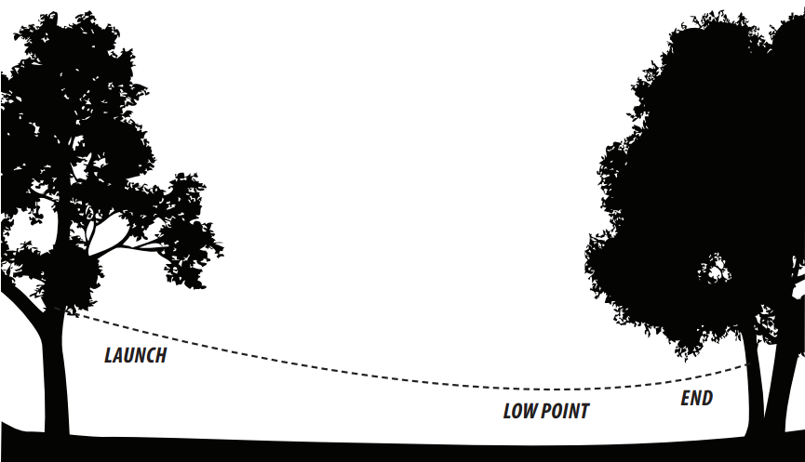
What form does the shape of the cable take?f

Slide 6
The question has a storied past … Galileo maintained the curve was a parabola … which was later disproven by Jungius in 1669.
Jakob Bernoulli proposed the challenge to obtain an equation for this curve which was ultimately met by Leibniz, Huygens and Johann Bernoulli in 1691. It was Huygens who coined the name CATENARY for this curve … which is appropriately derived from the Latin word for “chain” … or perhaps inappropriately
if you don’t speak Latin.
Catenary Curve
y = acosh$\left(\frac{x}{a}\right)$

Slide 7
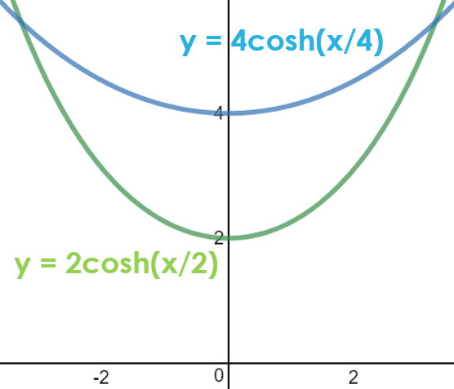
Catenary Curve
y = acosh$\left(\frac{x}{a}\right)$
The constant represents the
y-intercept … or more importantly for our consideration … the curvature of the catenary curve.
What does the constant value ‘a’ represent on the curve?
Interesting side note … the radius of curvature at x = 0 is also ‘a’
$$ρ= \frac{{\left(1+{f^{′}(x)}^{2}\right)}^{1.5}}{f"(x)}$$

Slide 8
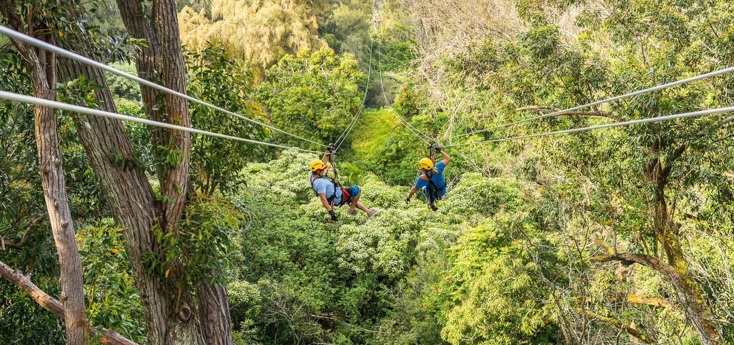
Find the catenary equation with the proper curvature so that someone can enjoy the benefits of gravity and slide down with enough sag in the cable to enable them to reach the landing, but at a reasonable speed.
The problem:

Slide 9
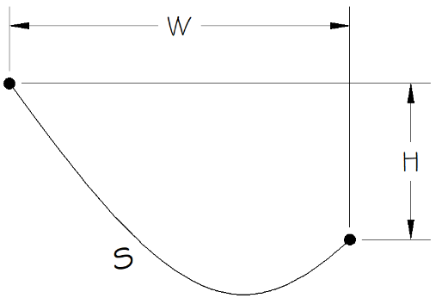
Givens for a particular zip-line design: W = width between the supports H = height between the supports s = arc length of the cable Find a function y(x) to model the curve

Slide 10
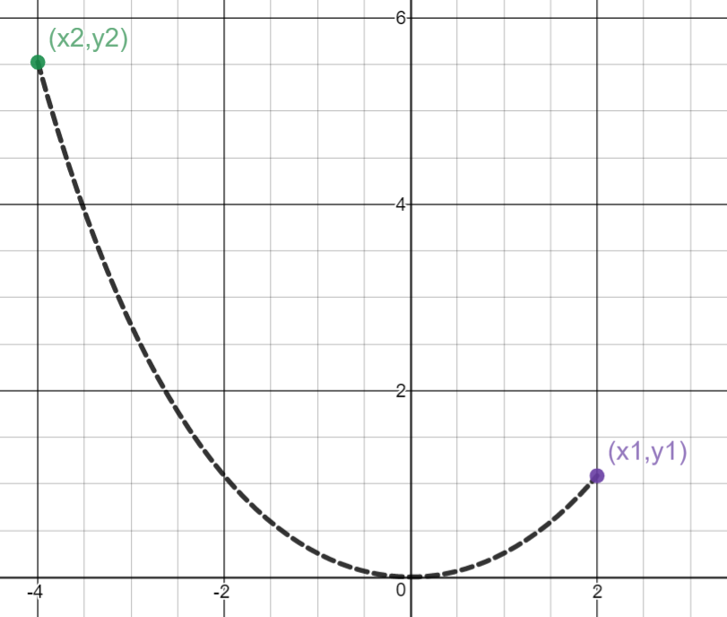
Solution: (1) $y=acosh\left(\frac{x}{a}\right)−a$ … the equation of the catenary passing through the origin. All we need now is a value for the constant a. Derivation of the catenary equation: http://go.roguecc.edu/user/dgardner •Math Outside the Box •Powerful Lines at Work

Slide 11
(2) $y_{1}=acosh\left(\frac{x_{1}}{a}\right)−a$ … one solution (3) $y_{2}=acosh\left(\frac{x_{2}}{a}\right)−a$ … another solution (4) $y_{1}+H= y_{2}$ (5) $x_{2}+W= x_{1}$ (6) $\cosh^{2}t− \sinh^{2}t=1$ … hyperbolic identity (7) $s= \int_{x_{2}}^{x_{1}}{\sqrt{1+ \sinh^{2}\left(\frac{x}{a}\right) }}$ … the arc length formula from calculus

Slide 12
(8) $s=asinh\left(\frac{x_{1}}{a}\right)−asinh\left(\frac{x_{2}}{a}\right)$ … evaluating integral (7) using identity (6) (9) $s=asinh\left(\frac{x_{2}+W}{a}\right)−asinh\left(\frac{x_{2}}{a}\right)$ … combining (5) & (8) (10) $x_{1}= {asinh}^{−1}\left(\frac{s}{a}+ asinh\left(\frac{x_{2}}{a}\right)\right)$ … solving (8) for x₁ (11) $y_{1}=acosh\left(\sinh^{−1}\left(\frac{s}{a}+ asinh\left(\frac{x_{2}}{a}\right)\right)\right)−a$ … combining (2) & (10) (12) $y_{1}+H=acosh\left(\frac{x_{2}}{a}\right)−a$ … combining (3) & (4)

Slide 13
(13) $cosh\left(\sinh^{−1}\left(\frac{s}{a}+ sinh\left(\frac{x_{2}}{a}\right)\right)\right) +\frac{H}{a}=cosh\left(\frac{x_{2}}{a}\right)$ … combining (11) & (12) … now to solve (13) for x₂ (14) $cosh\left(\sinh^{−1}\left(x\right)\right)= \sqrt{1+ x^{2}}$ … hyperbolic identity (15) $\sqrt{1+ {\left(\frac{s}{a}+ sinh\left(\frac{x_{2}}{a}\right)\right)}^{2} }+\frac{H}{a}=cosh\left(\frac{x_{2}}{a}\right)$ … combining (13) & (14) (16) $s^{2}+2sasinh\left(\frac{x_{2}}{a}\right)= H^{2}−2Hacosh\left(\frac{x_{2}}{a}\right)$ … algebraically cleaning up (15)

Slide 14
(17) $x_{2}=aln\left(\frac{H^{2}− s^{2}+ \sqrt{{\left(s^{2}−H^{2}\right)}^{2}−4a^{2}\left(H^{2}− s^{2}\right)}}{2a(H+s)}\right)$ … replacing the hyperbolic trig expressions in (16) with their exponential equivalents: $coshx=\frac{e^{x} +{ e}^{−x}}{2}$ & $sinhx=\frac{e^{x} −{ e}^{−x}}{2}$ to solve for x₂ (18) $s=asinh\left(ln\left(\frac{H^{2}− s^{2}+ \sqrt{{\left(s^{2}−H^{2}\right)}^{2}−4a^{2}\left(H^{2}− s^{2}\right)}}{2a(H+s)}\right)+\frac{W}{a}\right)−asinh\left(ln\left(\frac{H^{2}− s^{2}+ \sqrt{{\left(s^{2}−H^{2}\right)}^{2}−4a^{2}\left(H^{2}− s^{2}\right)}}{2a(H+s)}\right)\right)$ … substituting (17) into (9) … angels singing … we have a single equation to solve for a •Which is trivial task … left as an exercise to the reader ☺

Slide 15
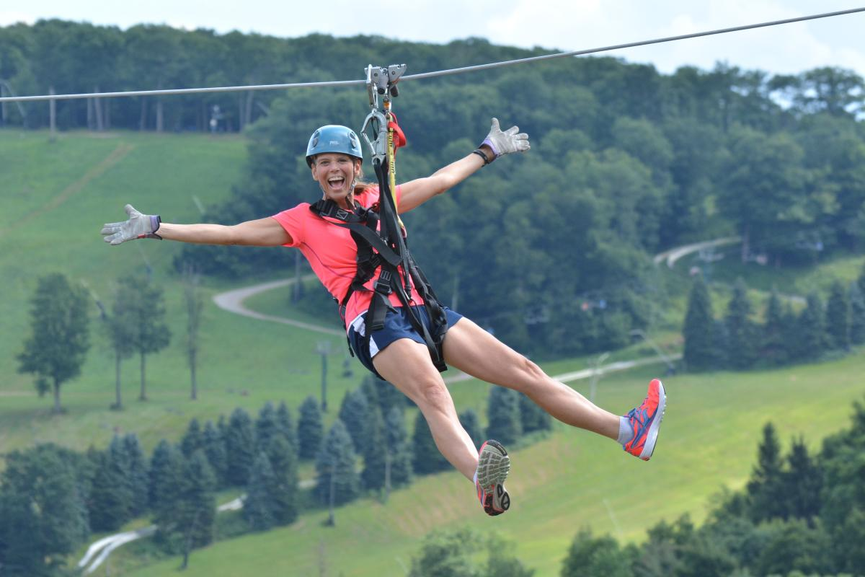
Now to see what the Zipline manufacturers have to say about our choices for W, H & S:

Slide 16
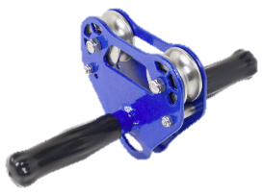
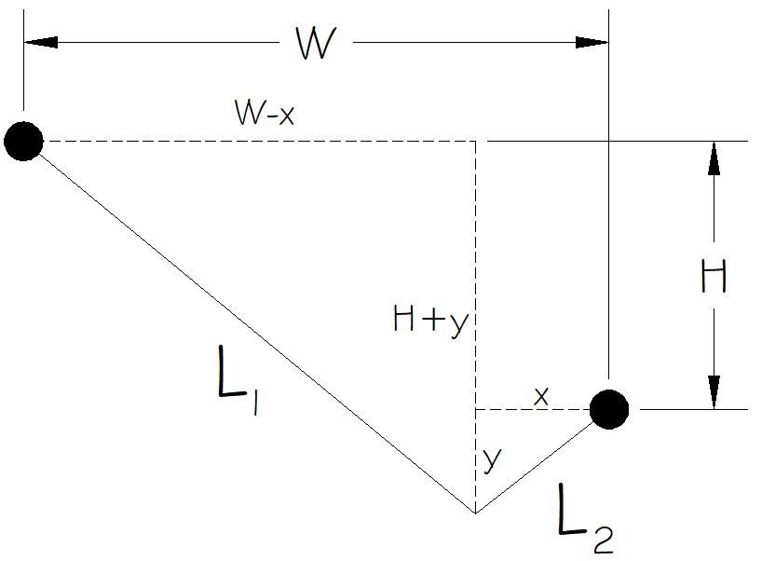
Zipline manufacturer recommendations:
The slope (H/W) from start to finish should be 3 – 6% … depending on the friction coefficient of the trolley
A cable should sag approximately 2% of its length (S) as measured from the low point … the sag (y) is measured when the cable is pulled tight from the lower support.

Slide 17
The cable will find its lowest sag (largest y)
when the right triangles are similar
(1) $\frac{W−x}{H+y} = \frac{x}{y}$ … similar triangles are proportionate
(2) $L_{1}+ L_{2}=S$
(3) $\sqrt{{(W−x)}^{2}+{(H+y)}^{2}} +\sqrt{x^{2}+ y^{2}}=S$
… Pythagorean Theorem with (2)

Slide 18
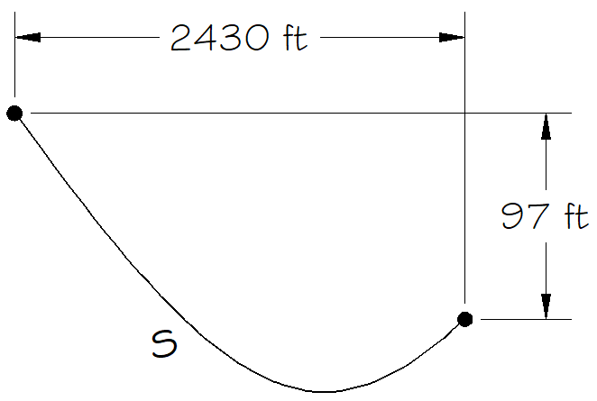
Putting it all together:
Suppose we want a zip-line with a horizontal distance of W = 2430 ft
If we choose a trolley that will allow a 4% slope then .04 * 2430 = H ≈ 97 ft.
And now .02S = y
Substituting these values for W, H & y into (1) & (3)
(1) $\frac{2430−x}{97+.02S} = \frac{x}{.02S}$
(3)$\sqrt{{(2430−x)}^{2}+{(97+.02S)}^{2}} +\sqrt{x^{2}+ {.O2S}^{2}}=S$
and solving the system graphically yields a value for S ≈ 2437.8 ft.
And substituting these values for W, H and S back into (18) and solving yields a value for a ≈ 10096 ft and an unweighted sag ≈ 32.8 ft.

Slide 19
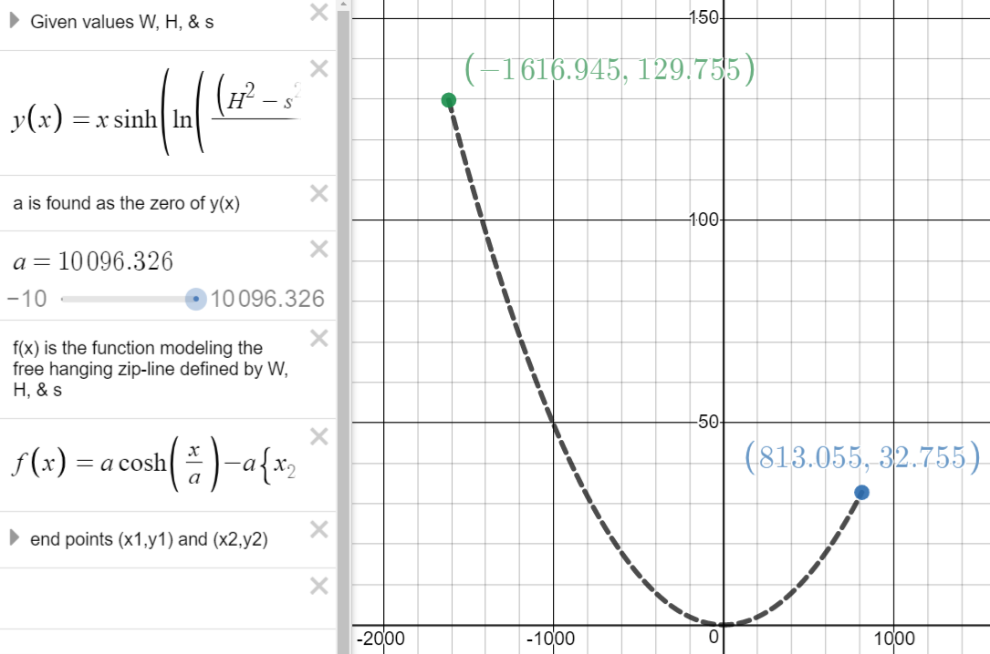
Note:
W = 2430 ft
H = 97 ft
S ≈ 2438 ft
sag ≈ 32.8 ft
When a = 10,096

Slide 20
let’s test out the Unreasonable Effectiveness of Mathematics in the Natural Sciences
https://www.desmos.com/calculator/flxv4jjxe1 W = 130 cm H = 20 cm S = 148 cm

Slide 21
Doug Gardner – RCC
dgardner@roguecc.edu

Slide 22
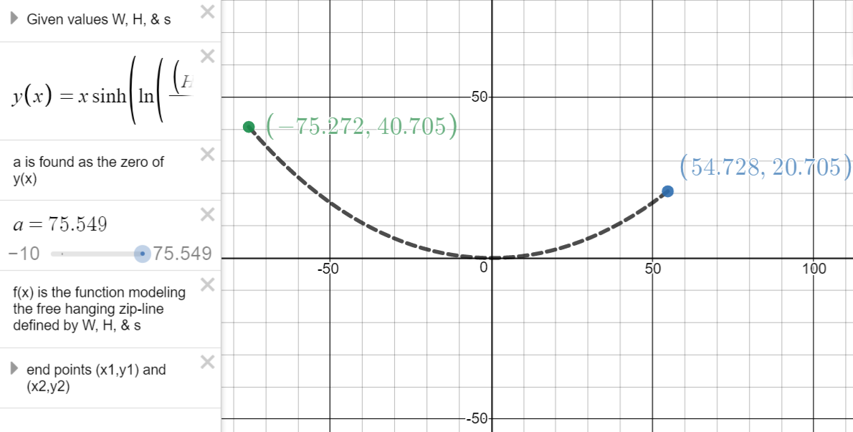

Slide 23
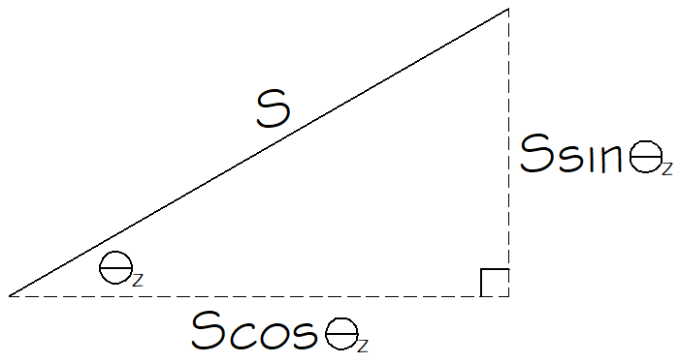
Manufacturers Recommendations: To calculate the angle of elevation of the Zipline Ɵ_{z} for a desired velocity of arrival: Givens: mass (m) gravitational constant (g) desired velocity at the end of the ride (v) friction coefficient (tanƟ_{f} ) … Ɵ_{f} is the angle at which the pulley begins to slide (1) mgSsinƟ_{z}– tanƟ_{f} mgcosƟ_{z}*S = 0.5mv²… work(g)-work(μ)=energy (2) sinƟ_{z}– tanƟ_{f} cosƟ_{z} = $\frac{v^{2}}{2gS}$

Slide 24
(3) $\sqrt{1−\cos^{2}θ_{z} }\text{= }\frac{v^{2}}{2gS}$ $\text{+} \text{tan}\text{Ɵ}\text{f} \text{cos}\text{Ɵ}\text{z}$ (4) $1−\cos^{2}θ_{z}= {\left(\frac{v^{2}}{2gS}\right)}^{2}+2\left(\frac{v^{2}}{2gS}\right){tanθ}_{f}{cosθ}_{z}+{\left({tanθ}_{f}{cosθ}_{z}\right)}^{2}$ (5) $\left(1+\tan^{2}θ_{f}\right)\cos^{2}θ_{z}$+$\left(\frac{{v^{2}tanθ}_{f}}{gS}\right){cosθ}_{z}$+${\left(\frac{v^{2}}{2gS}\right)}^{2}−1=0$ (6) $θ_{z}=\cos^{−1}\left(\frac{−\frac{{v^{2}tanθ}_{f}}{gS} +\sqrt{{\left(\frac{{v^{2}tanθ}_{f}}{gS}\right)}^{2}−4\left(1+\tan^{2}θ_{f}\right)\left({\left(\frac{v^{2}}{2gS}\right)}^{2}−1\right)}}{2\left(1+\tan^{2}θ_{f}\right)}\right)$ https://www.desmos.com/calculator/gfvx7xuins

