Slide 1
Reinventing the Rigorous Foundations of Calculus in a Bridge Course
Mark A. Yannotta marky@clackamas.edu
Brittney Ellis bm3@pdx.edu
Collin Anderson
Laura Nosler
Phil Nosler

Slide 2
What is a mathematics bridge course?
Often synonymous with a transition or transition-to-proof course, Selden & Selden (1995) describe a bridge course as being “designed to ease the transition from lower division, more computational, mathematics courses to upper division, more abstract, mathematics courses such as modern algebra and advanced calculus.”
Notes:
2
MARK

Slide 3
You may ask yourself "How did I get here?"

Slide 4
Math 205: A Bridge To University Mathematics
Math 205 originated as Math 299 in the spring of 2005
A group of students had exhausted our mathematics courses and were looking for something that would help prepare them prior to transferring
This elective course has been taught annually in a variety of formats at Clackamas Community College for the past 14 years
Notes:
4
MARK
In 2005, a group of students came to my dept. chair and asked if there were any other math classes they could take. My chair asked myself and another instructor if we would teach a 3-week unit of more advanced math to these students. We did this pro bono and we all agreed that it was well worth our time.
Math 299 originated in the spring of 2005, when a group of ten students led by Adam Omidpanah-Clark approached Stefan Baratto about running a mathematics topics course.

Slide 5
The Evolution of Math 299
Year | #Stu | #I | Curriculum
2005 | 10 | 3 | Proof, topology, group theory
2007 | 6 | 1 | Group theory, proof, math history
2008 | 6 | 2 | Group theory (g.r.), topology
2009 | 9 | 1 | Group theory (g.r.)
2010 | 13 | 1 | Group theory (g.r.)
2011 | 14 | 1 | Group theory (g.r.)
Notes:
5
MARK

Slide 6
The Evolution of Math 205
Year | #Stu | #I | Curriculum
2012 | 20 | 1 | Group theory (g.r.)
2014 | 16 | 1 | Group theory (g.r.)
2015 | 10 | 1 | Sets, analysis, topology
2016 | 12 | 1 | Group theory (g.r.),
2017 | 23 | 1 | Sets, analysis, topology
2018 | 11 | 1 | Group theory (g.r.)
Notes:
6
MARK

Slide 7
The Evolution of Math 205
Year | #Stu | #I | Curriculum
2019W | 7 | 1 | Advanced calculus (g.r.)
2019Su | ? | 1 | Group theory (g.r.)
2020W |  | 1 | Set theory, proof
2020Su |  | 1 | Advanced calculus (g.r.),
Notes:
7
MARK

Slide 8
Portland State University
Mathematics Minor Requirements
These courses can be taken at community colleges
Mth 251, 252, 253, 254: Calculus I-IV (16)
Mth 256: Differential Equations (4)
Mth 261: Introduction to Linear Algebra (4)
A GAP IN THE CURRICULUM
These courses are taken at the University
Mth 311: Advanced Calculus (4)
OR
Mth 344: Group Theory (4)
Focus student preparation on one or both of these required courses
Two additional approved elective courses (8)
Notes:
8
MARK
*For a math minor, students must choose 1 of the 300-level courses
and 3 upper-level Mth/Stat electives

Slide 9
What are some of the challenges that students encounter as they transition to more abstract mathematics?
Number systems
Sets and set notation
Proofs
Argumentation
Conventions of mathematical notation and terminology
Our students arrive at our higher-level courses from a wide variety of backgrounds. Gaps are inevitable no matter how well we put together a developmental curriculum.
Notes:
MARK
Empowering: When you know or have been exposed to content that makes new material seem familiar.
Disempowering: Feeling like your classmates are ahead of you, when you hear your classmates using terminology or notation you have not encountered.
Basic proofs: trig-style identities, don’t start with conclusion, are the steps reversible, formal and informal proofs
Argumentation make a point and support it verbally
Conventions: “Trivial” and “By inspection”, “neighborhood”, “open ball”
9

Slide 10
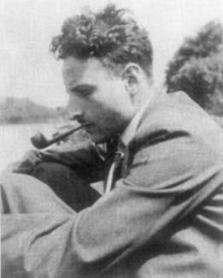
Hans Freudenthal (1905 – 1990)
German mathematician who relocated to the Netherlands prior to 1933
Stripped of his university position (1940), escaped from a Nazi labor camp (1943), and went into hiding
Appointed as professor at Utrecht University (1946)
Founded the academic journal, Educational studies in mathematics in 1968 and used it as a platform for RME
Adamantly opposed New Math and mechanistic teaching
Wrote China Lectures (1991)

Slide 11
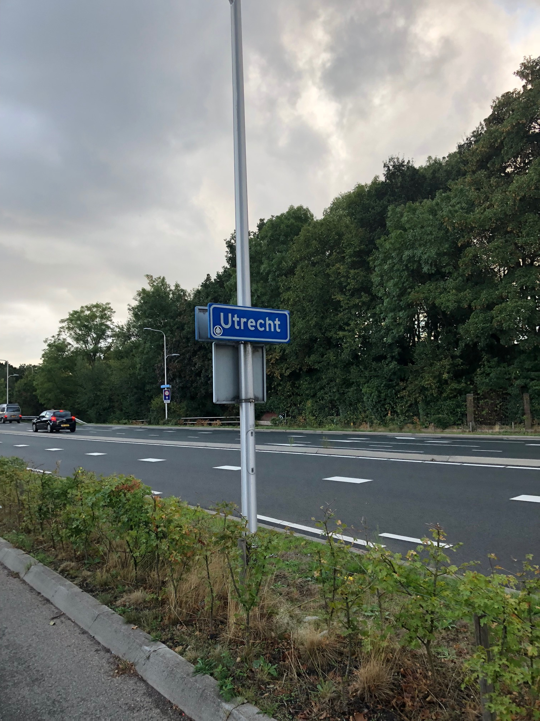
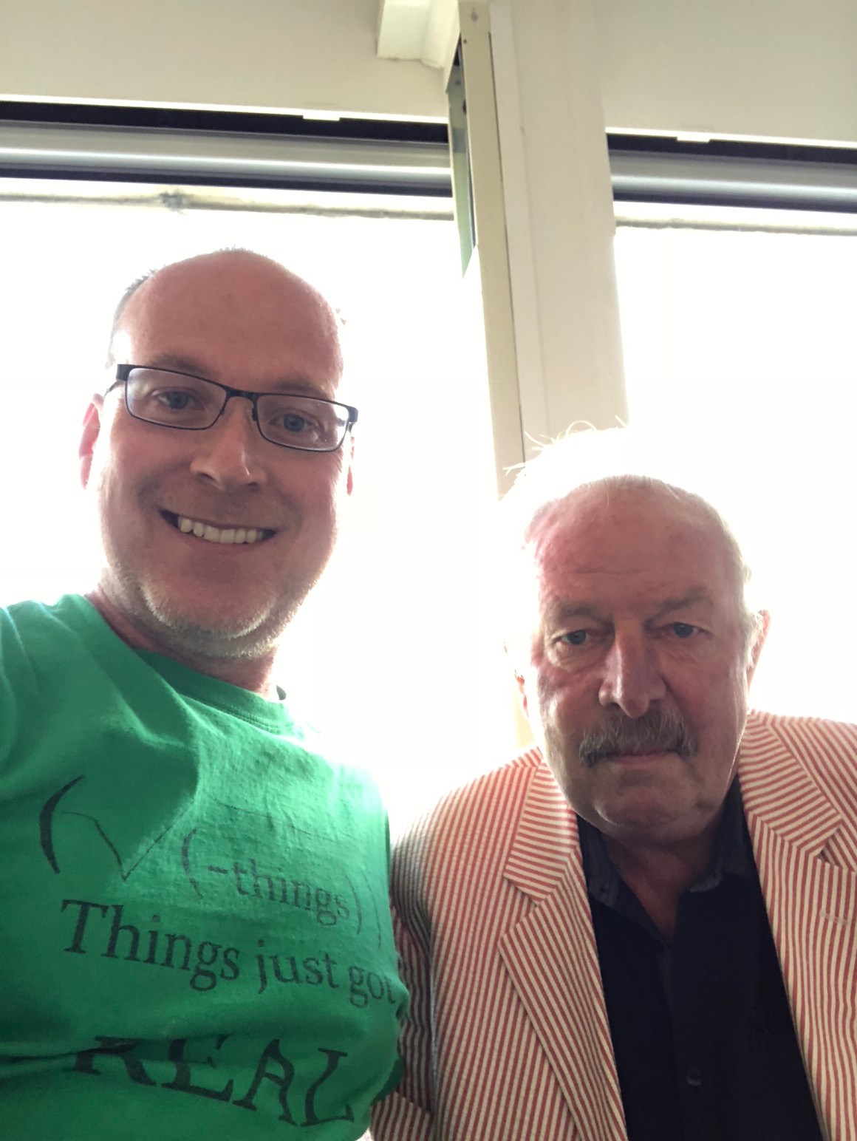
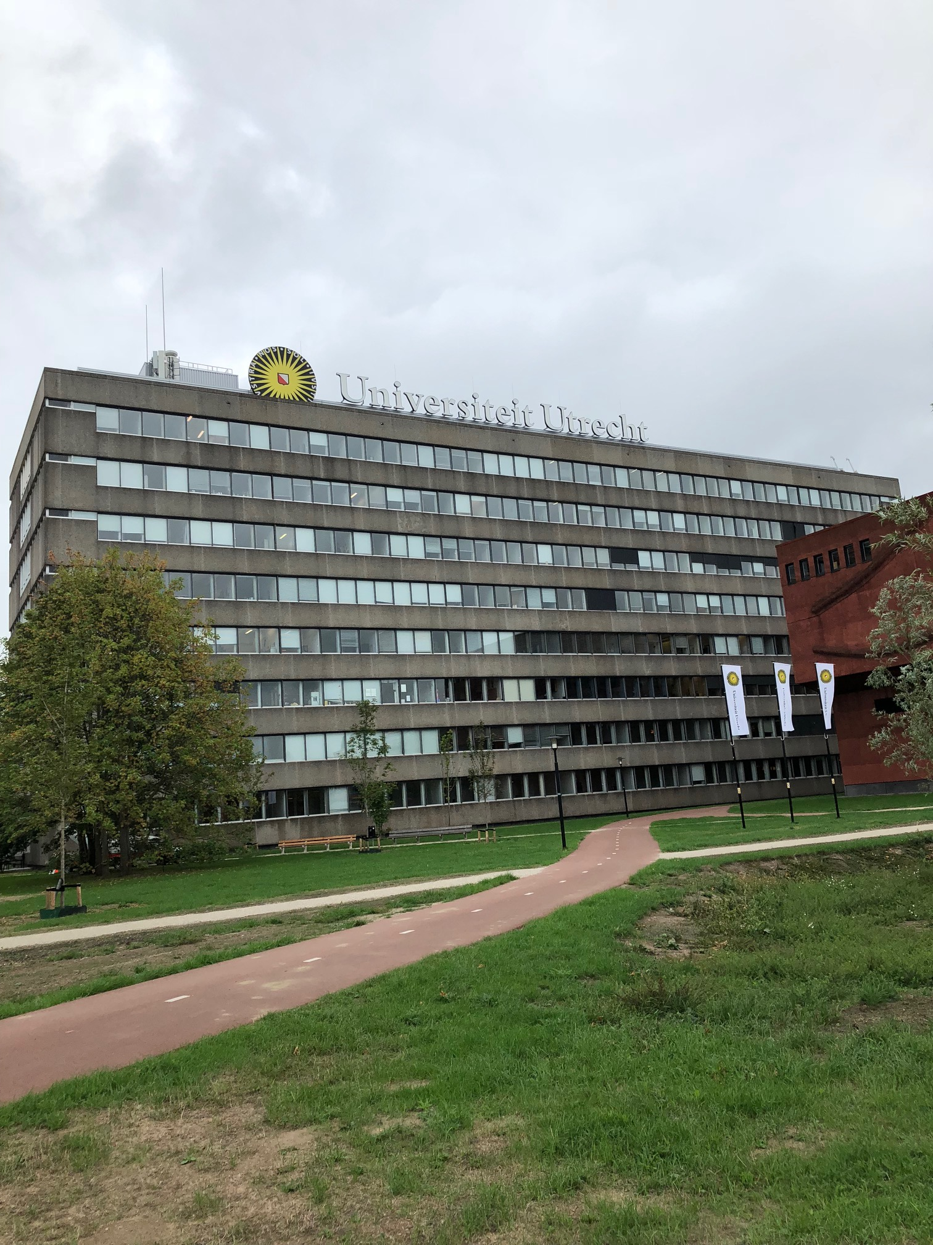
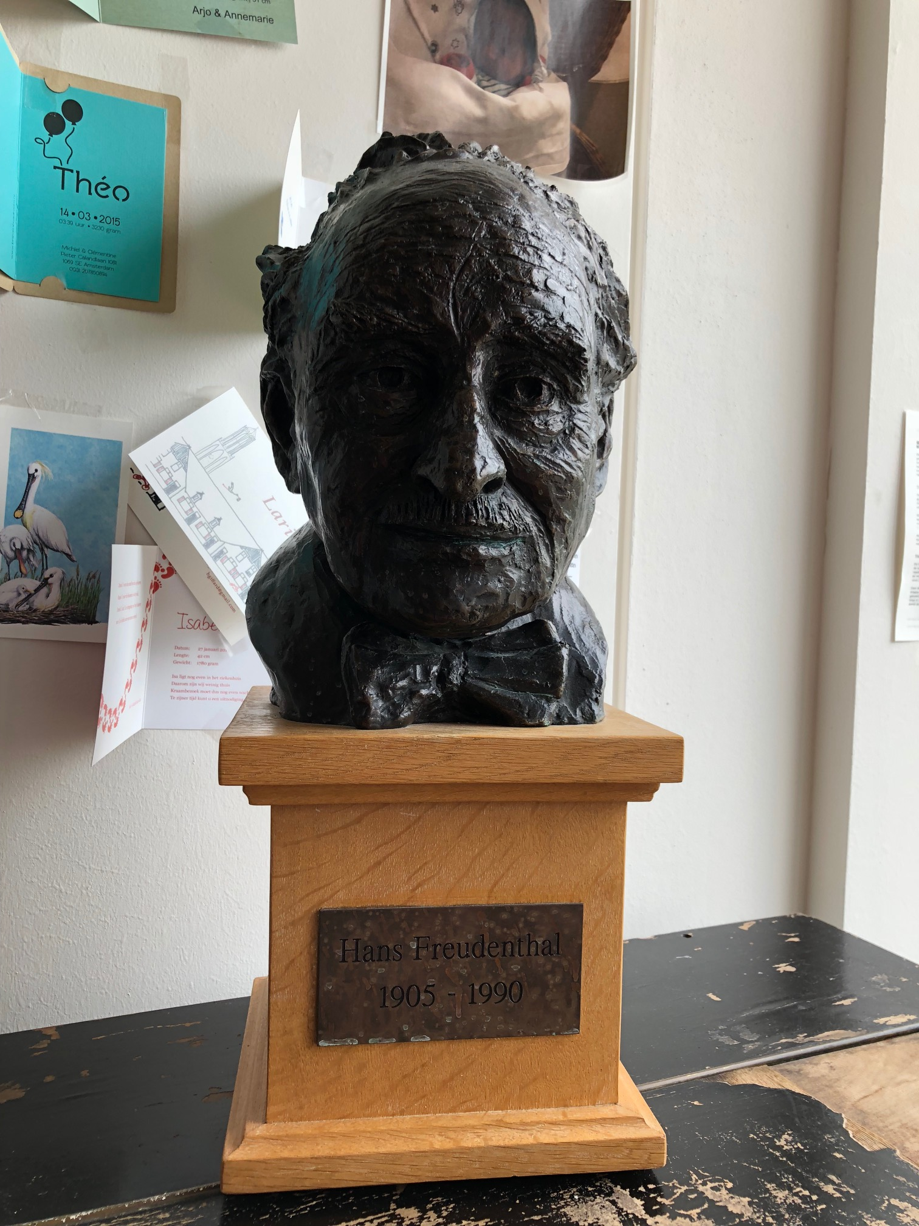
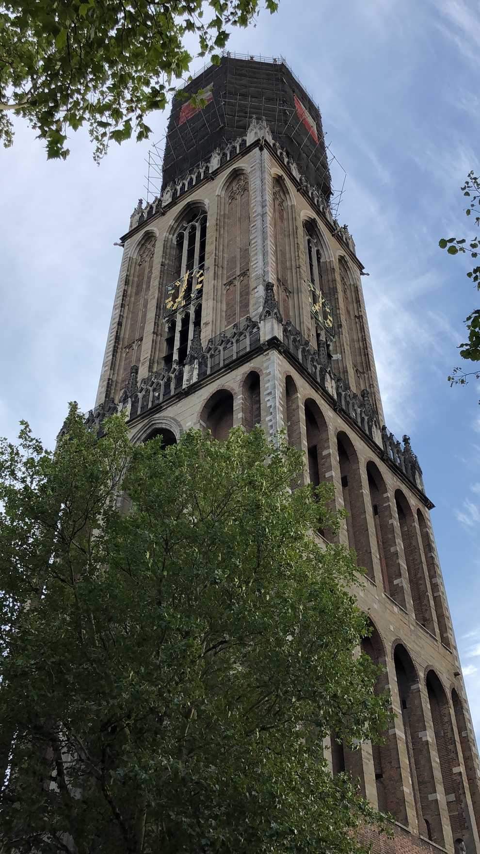
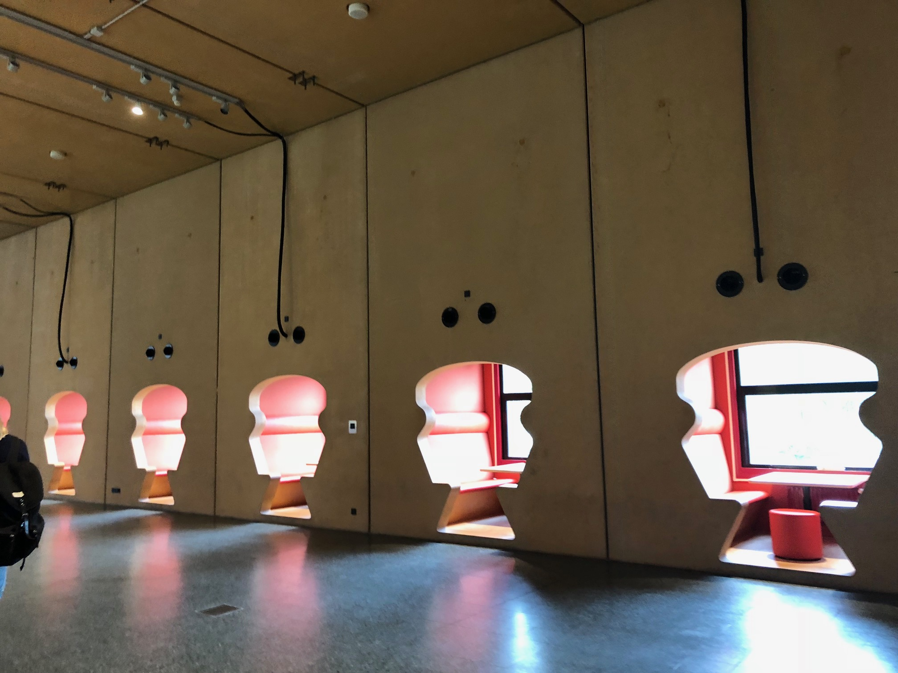

Slide 12
Realistic Mathematics Education
RME places a strong emphasis on two key features:
Mathematics is situated
as a dynamic human
activity.
2) Mathematics must be
connected to the reality of
everyday life.
Notes:
Learning mathematics is doing mathematics. Freudenthal suggests that students should engage in mathematical activities through a process called guided reinvention.
2. Freudenthal further argued that it was not sufficient for these activities to originate from the real world; they must also become real in a student’s mind.

Slide 13
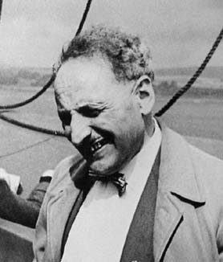
RME in the classroom
Freudenthal argued that students should be given opportunities to mathematize and be guided to reinvent mathematics developing concepts based on their intuition, informal strategies, and prior knowledge.

Slide 14
Benefits of guided reinvention
Freudenthal (1991) argues that, “knowledge and ability, when acquired by one’s own activity, stick better and are more readily available than when imposed by others” (p. 47).
The students actively participate in developing symbols, notation systems, definitions, and theorems.

Slide 15
Reinventing rigorous foundations of calculus
Expands on a LIT (local instructional theory) developed by Strand, S. (2016)
Students begin by constructing a method for approximating roots of a 5th degree polynomial
Rooted (ha) in Cauchy’s proof of the Intermediate Value Theorem (IVT)
Advanced calculus concepts that students reinvent:
Limits, sequences, and convergence
Continuity
Completeness
Students have the opportunity to experience more formal mathematical activity such as defining, making conjectures, and proving
Notes:
B - talk about the project and ASPIRE in math proposal

Slide 16
ASPIRE in Math Project Proposal
A collaboration between 2-year and 4-year institutions

Slide 17
ASPIRE in Math Project Proposal
The proposed NSF project will provide several products as a result of the development processes:
Curriculum modules
Real analysis
Abstract algebra
Online instructor support materials (OISM)
Wiki-Style textbook (Wiki-text)
Professional development workshop (PD Workshop)
Research articles connected to:
Students’ mathematical learning
Professional development
Proof Modules!
Notes:
B - talk about the project and ASPIRE in math proposal (Advancing Students’ Proving through Inquiry, Reinvention, and Engagement)

Slide 18
My involvement and research interests
I am finishing my second year of a PhD in Math Education at PSU.
I have been involved in this project for a little over a year (since winter 2018)
Refining LIT, supporting data collection and analysis
General research interests prior to joining the team were:
Research in undergraduate mathematics education (RUME)
How students transition to proof-based mathematics
Students’ development and understanding of advanced math
Since then my research interests have grown to include:
Understanding inequities in collaborative group work
Fair access to participation in mathematical discussion and access to mathematical content in active learning environments
Notes:
B - my role/interest in the project

Slide 19
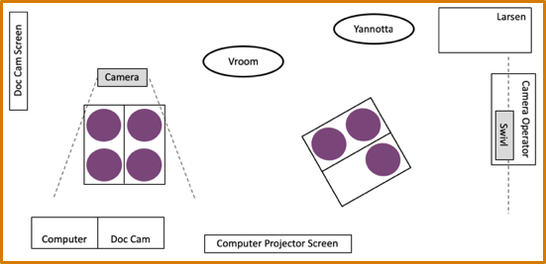
Classroom Setup and Swivl®
Notes:
B - Discuss the Swivl technology and how it was used during the course

Slide 20
The Swivl®
1 primary marker
4 expansion markers

Slide 21
What is EQUIP?
EQUIP (Equity QUantified In Participation) is an observation tool that supports teachers, researchers, and professional developers in creating more equitable classroom environments (Reinholz & Shah, 2018).
Several features of EQUIP include:
Used in live classroom settings or retrospectively through video observations
Designed to give an instant analytic report once an observation is completed
Customizable observation tool
For example, I looked at students’ participation within small groups as well as in whole-class discussions by creating a new “classroom” for each small group
For more info about EQUIP visit: https://www.equip.ninja
Notes:
B - other relevant research (EQUIP)
(citation) Reinholz, D., & Shah, N. (2018). Equity analytics: A methodological approach for quantifying participation patterns in mathematics classroom discourse. Journal for Research in Mathematics Education, 49(2), 140-177.

Slide 22
Using EQUIP for this project
Each week during the CCC bridge course, I used video observation data generated by Swivl® to document students’ participation using EQUIP.
In small group interactions, I documented student talk length
1-4 words, 5-20 words, 21+ words
In whole-class discussions, I documented student talk length along with:
Teacher solicitation type
What, How, Why, None, Other
Teacher solicitation method
Called on, Not called on
Analytics generated from these observations informed instructional decisions for the following week.
Notes:
B - (EQUIP)

Slide 23
Student Perspectives on MTH-205

Slide 24
Students’ Mathematical Backgrounds
Phil | Laura | Collin
Calculus I | Calculus I | College Algebra
Calculus II | Calculus II | Pre-Calculus/Trig
Differential Equations | Differential Equations | Calculus I
Linear Algebra | Linear Algebra | Calculus II
 | Vector Calculus | Calculus III
 |  | Statistics I

Slide 25
Structure of MTH-205
Class was devoted to group discussions and development of our ideas. It was a conversation rather than a lecture.
Discussions in class carried over to homework.
Journal Prompts
Homework
Topics included root approximation methods, limits, sequences, continuity, and phrasing and testing conjectures.
Guiding questions almost never had a single correct answer.
Two main methods for root approximation were created, the Bisection Method and the Decimal Expansion Method.

Slide 26
Some student work & journal prompts
At the end of class, we came up with the following definition: A sequence {$a_{n}$} is bounded if and only if ${|a}_{n}|<K$where K is a real number and n is any natural number.
Prompt 1. This statement seems to capture our idea, but in math we tend to use the words "there exists" and "for all" to allow us to be more precise with our meanings. Rewrite the definition for bounded so that it uses "there exists" and "for all".
Prompt 2. Tweak this definition to write a new definition for bounded above. That is, fill in the following: A sequence {$a_{n}$} is bounded above if and only if...
Prompt 3. Propose a definition of unbounded above (using "there exists" and "for all").
Prompt 4. Come up with an example that is unbounded above but does not go to infinity.
Prompt 5. Tweak your definition of unbounded above to define sequence convergence to infinity. That is, fill in the following: $a_{n}$ →∞ as n→∞ for some sequence {$a_{n}$} if and only if...
Prompt 1: We all think that limk→∞bk−ak=0 using the bisection method. We want to prove this! So, suppose that we think that limk→∞cn=0 for some sequence {cn}. How do we go about proving that?
Prompt 2: Write a proof that the sum of any two odd numbers is an even number.

Slide 27
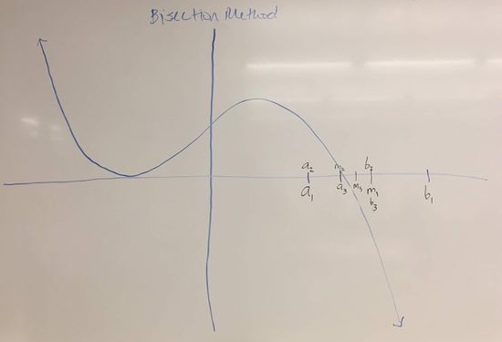
The Bisection Method
1. Choose a left endpoint and a right endpoint so that the endpoints’ outputs are of opposite sign and the endpoints are within at least one integer value to each other.
-----------------------------------------------
2. Find the midpoint and evaluate its output.
------------------------------------------------
3. Change the bounds so that the midpoint replaces the bound whose output is of the same sign.
------------------------------------------------------
For each step, the root approximation is taken to be the midpoint.
Relevant Sequences
$\{a_{n}\}$ – Sequence of left endpoints
$\{b_{n}\}$ – Sequence of right endpoints
$\{m_{n}\}$ – Sequence of midpoints
$\{L_{n}\}$ – Sequence of interval lengths

Slide 28
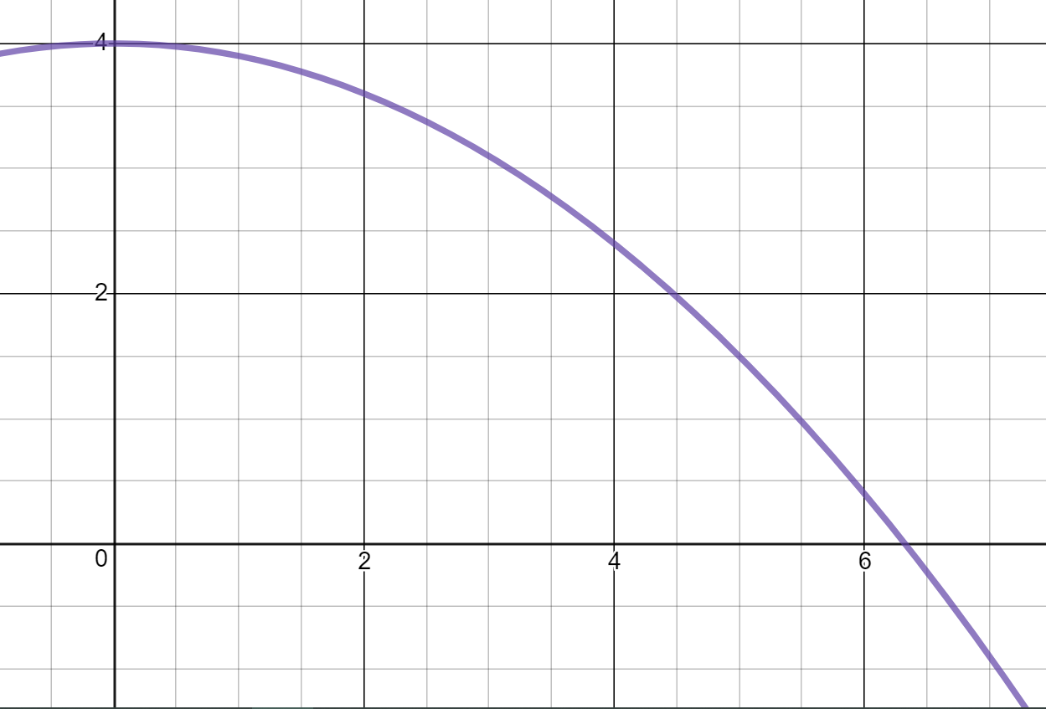
How the Bisection Method Works
$$y=f(x)$$
$$f\left(x\right)=4−\frac{x^{2}}{10}$$
All graphs drawn in Desmos

Slide 29
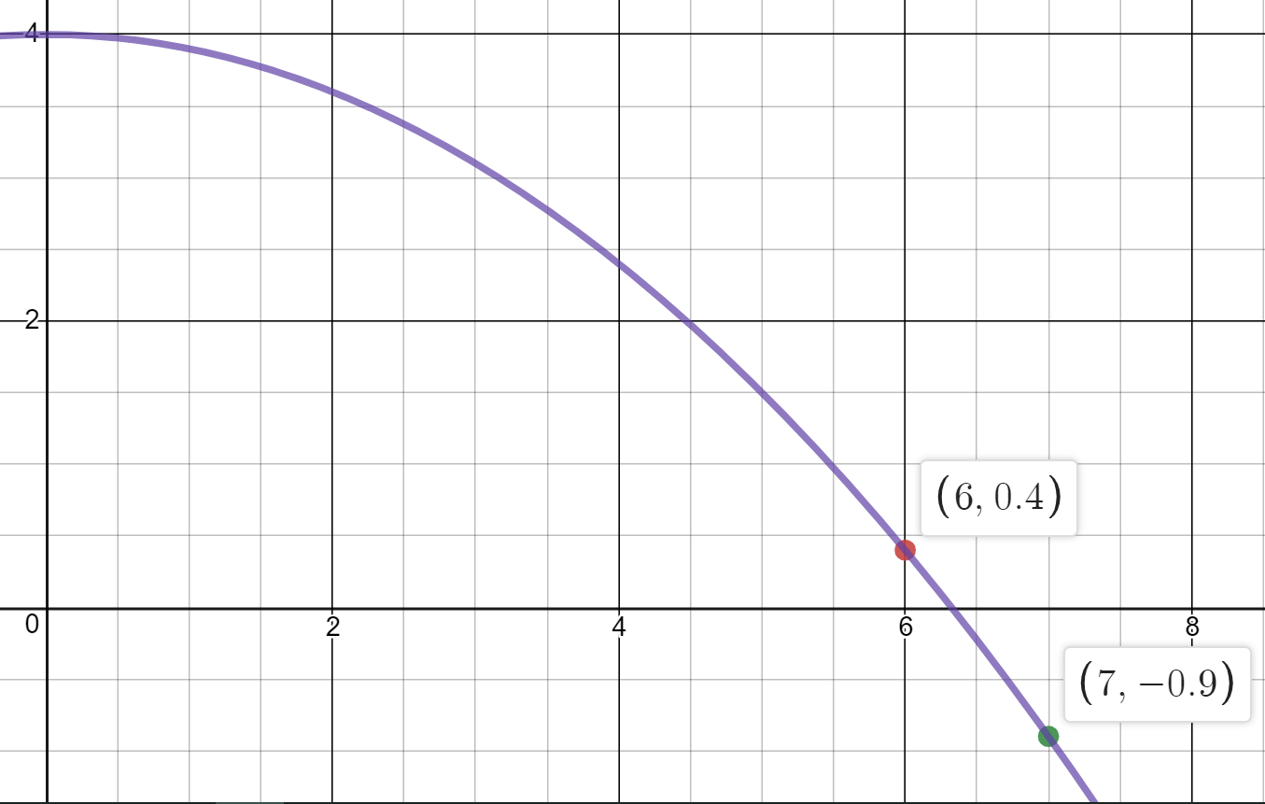
Step 1: Find $a_{1}$ and $b_{1}$
First Left Endpoint:
$$a_{1}=\left(6, 0.4\right)$$
First Right Endpoint:
$$b_{1}=(7, −0.9)$$
$$a_{1}$$
$$b_{1}$$

Slide 30
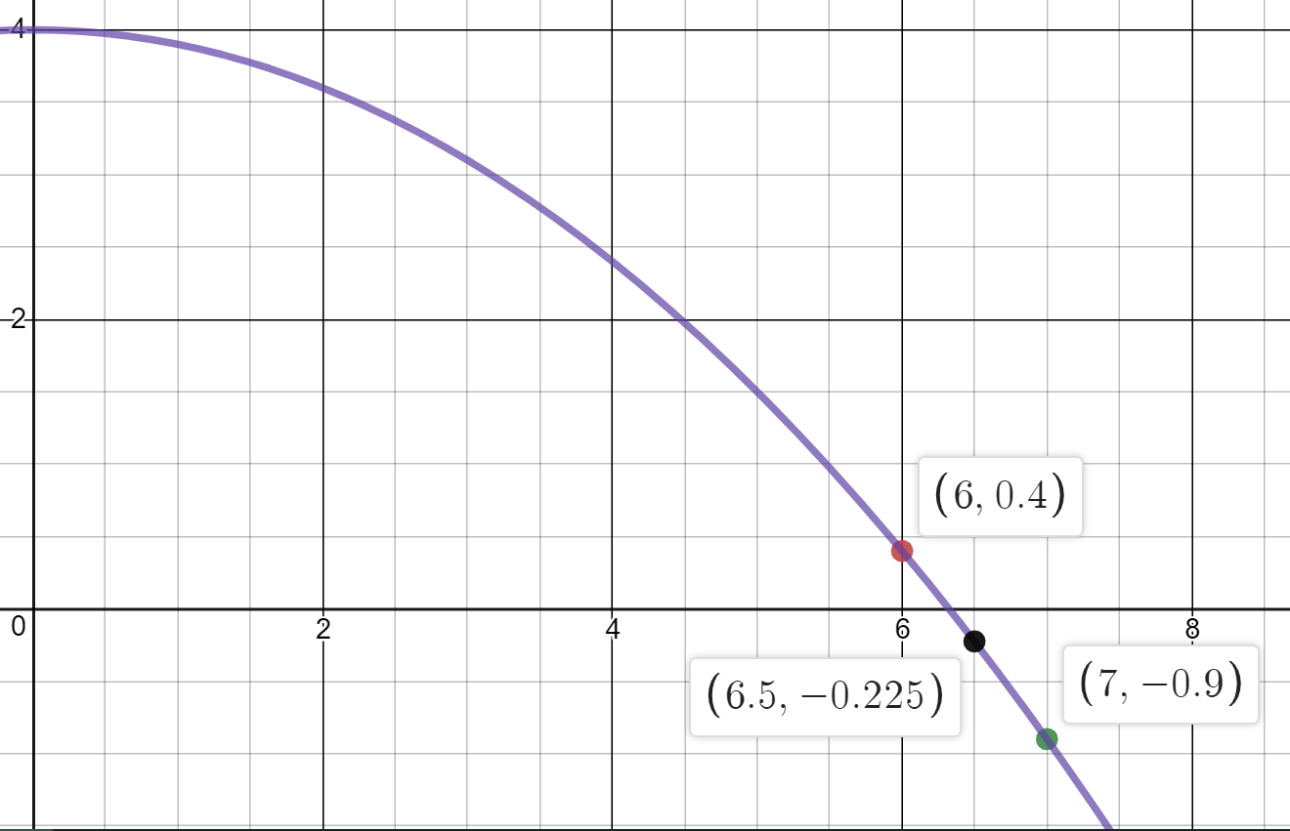
Step 2: Find $m_{1}$ – The First Midpoint
First Midpoint:
$$m_{1}=\left(6,.5 −0.225\right)$$
$$a_{1}$$
$$m_{1}$$
$$b_{1}$$

Slide 31
Step 3: Redefine the Bounds
$$a_{2}$$
Second Left Endpoint:
$$a_{1}=a_{2}=\left(6, 0.4\right)$$
Second Right Endpoint:
$$m_{1}=b_{2}=(6.5, −0.225)$$
$$b_{2}$$

Slide 32
Conjectures About the Bisection Method
The sequence of midpoints $\{m_{k}\}$ converges to the root, but it is unsure if the sequence converges from the left of the right.
As $k→ ∞$ , $\{L_{k}\}$approaches 0.
The sequence of right endpoints $\left\{b_{k}\right\}$ must converge to the root.
As $k→ ∞$, $\{a_{k}\}$will approach the root from the left.
Any value between a and b could replace a or b as a new bound.
If the bisection method is run for an infinite number of steps, the approximation is infinitely accurate.
The sequence of left endpoints $\left\{a_{k}\right\}$ must converge to the root.
It takes more iterations of the bisection method to obtain the same degree of accuracy as the decimal expansion method.
If a continuous function has a positive value at $f(a)$ and a negative value at $f(b)$ then $f(a)$ and $f(b)$ will exist in two separate quadrants.
The outputs of $\left\{a_{k}\right\}$ and $\left\{b_{k}\right\}$ converge to the same number.
As $k→ ∞$, $\{b_{k}\}$will approach the root from the right.
As $k→ ∞$, the constituents of $\left\{I_{k}\right\}$, the sequence of intervals, will approach the root.
As $k→ ∞$, $\{m_{k}\}$will approach the root and become either the new $\{a_{k}\}$ or $\left\{b_{k}\right\}$.
If the outputs of$a_{k}$and$b_{k}$ are opposite signs, there must be a root between${ a}_{k} \text{and} b_{k}$

Slide 33
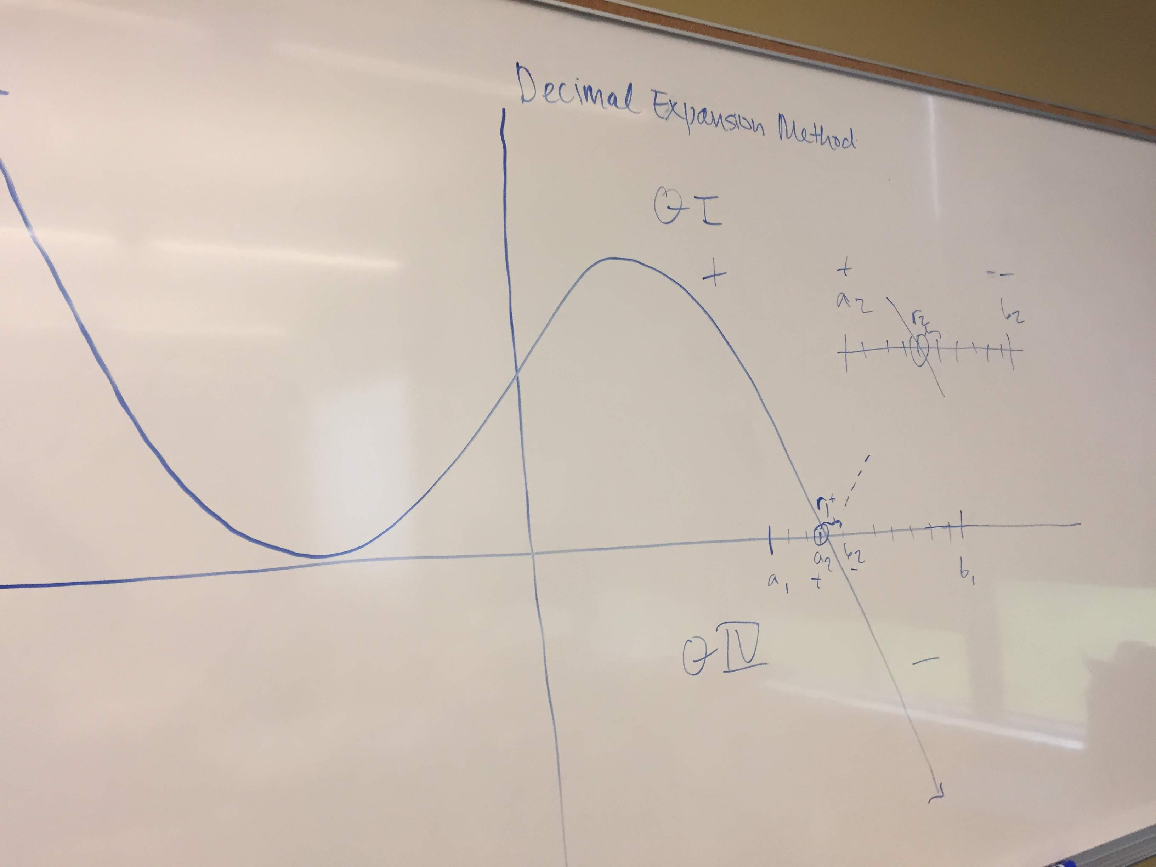
The Decimal Expansion Method
1. Choose a left endpoint and a right endpoint so that the endpoints’ outputs are of opposite sign and the endpoints are one apart.
-----------------------------------------------
2. Divide the region equally into ten fractions and calculate the output of each tenth.
------------------------------------------------
3. Identify the region in which a sign change for the outputs takes place. Subdivide this new region into tenths and repeat the process.
----------------------------------------------------------
For each step, the root approximation is taken to be the left bound of the narrowest calculated range.

Slide 34
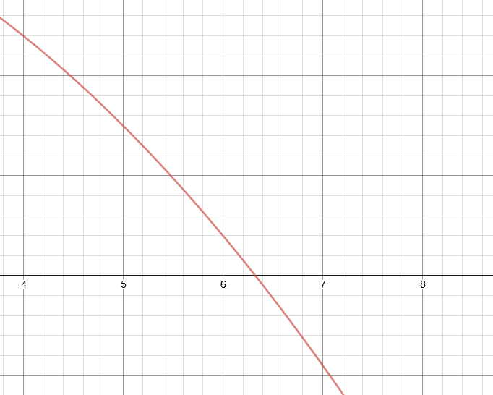
How the Decimal Expansion Method Works
An interval with length 1 is chosen with endpoints $a_{1}$ and $b_{1}$, where $a_{1}$ and $b_{1}$ are integers. This region is subdivided into ten equal fractions and the sign-change interval is identified.
$$y=f(x)$$
X-value | Y-value
6.0 | 0.4
6.1 | 0.279
6.2 | 0.156
6.3 | 0.031
6.4 | -- 0.096
6.5 | -- 0.225
6.6 | -- 0.356
6.7 | -- 0.489
6.8 | -- 0.624
6.9 | -- 0.761
7.0 | -- 0.9
$$a_{1}$$
$$b_{1}$$
All graphs drawn in Desmos
$$f\left(x\right)=4−\frac{x^{2}}{10}$$

Slide 35
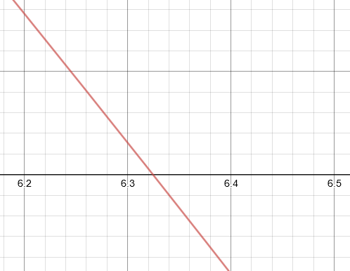
How the Decimal Expansion Method Works
The new interval is subdivided again into tenths and the outputs calculated at each step. The new, narrowest calculated sign-change interval is then identified.
$$y=f(x)$$
X-value | Y-value
6.30 | 0.031
6.31 | 0.0184
6.32 | 0.00576
6.33 | -- 0.0069
6.34 | -- 0.0196
6.35 | -- 0.0323
6.36 | -- 0.045
6.37 | -- 0.0577
6.38 | -- 0.0704
6.39 | -- 0.0832
7.40 | -- 0.096
$$a_{2}$$
$$b_{2}$$
$$f\left(x\right)=4−\frac{x^{2}}{10}$$
All graphs drawn in Desmos

Slide 36
Comparison of Approximation Methods
Approximation Accuracy (Measured in Max distance to root)
Bisection Method
$$Distance<\frac{(b−a)}{2^{k}}$$
Decimal Expansion Method
$$Distance<{10}^{−(k−1)}$$
Each method is capable of determining an exact value of a root to n decimal places, but neither is capable of finding an irrational root.
Data Generated
Bisection Method: A series of midpoints and the original two endpoints.
Decimal Expansion Method: A series of eleven by two tables.

Slide 37
Student Takeaways
We were impressed with the level of carefulness and thoughtfulness required to formalize conjectures.
The necessity of using definitions (established and from our own work) in creating a formal conjecture.
The context of use can shape which definition of a concept is most fitting.

Slide 38
Usefulness as a Bridge Course
There is flexibility in developing definitions to fit new scenarios.
Conventions in mathematics may be arbitrary.
Practice in exploring a given subject in detail.
No plug and chug
Careful logic tests
Surprising discoveries can come from looking at problems from new angles and with different questions.

Slide 39
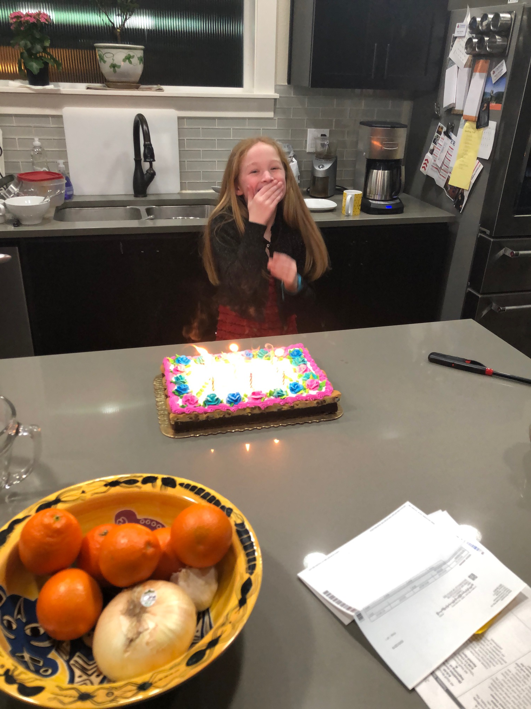
A final thought to ponder:
With Guided Pathways and all the great course development work already taking place around our state, it no longer has to be the SAME AS IT EVER WAS.
Adaptation
Tradition

