Slide 1
Math Corequisite Support Courses at Clark College
What we planned, what happened, and what we are going to do.
Notes:
If you have more than one person from your institution, please join separate groups.

Slide 2
Math Pathways Initiative
John Mitchell
Math Division Chair
jmitchell@clark.edu
Pre-College Math Reform
non-STEM Algebra
MATH092/096
Corequisite Support Courses
MATH104 Finite Mathematics with Support
MATH110 College Algebra with Support
STEM Algebra
MATH090/095
MATH102 College Trigonometry with Support
Kate Cook
kcook@clark.edu
Robert Weston
rweston@clark.edu
Notes:
Structural, pedagogical, and student experience changes. Success skills, growth mindset, productive persistence. Corequisite support courses have been running for a year, with a look towards continuous improvement.

Slide 3
A way to frame these courses:
We all do some review.
Prerequisite Topics
Course Topics
Let’s be clear about this connection!

Slide 4
What are Clark’s Math Corequisite Support Courses?
MATH105 Finite Mathematics
+
Prerequisite Topics
Success Skills
Course Supports
MATH104 Finite Mathematics with Support
Business
=
MATH111 College Algebra
Prerequisite Topics
Success Skills
Course Supports
MATH110 College Algebra with Support
+
=
STEM
MATH103 College Trigonometry
+
Prerequisite Topics
Success Skills
Course Supports
MATH102 College Trigonometry with Support
=
Notes:
Co-Requisite Support courses (also called Co-Requisite Remediation, or Supplemental Instruction) are designed to help students who place into pre-college math courses successfully pass college-level math courses. The course content of support courses is identical to the standard courses, however the support courses address deficiencies in prerequisite skills. It is recommended that faculty reuse as much material from MATH105 as you can; homework assignments, lectures and activities, assessments, etc.

Slide 5
What was your initial plan?
Standard Course
MATH105/103/111
5 quarter credit hours
5 contact hours
Support Course
MATH104/102/110
5 quarter credit hours
10 contact hours
Notes:
This is a fairly common approach of doubling the number of contact hours, and using this time to address prerequisite materials.

Slide 6
What did you settle on?
Standard Course
MATH105/103/111
5 quarter credit hours
Support Course
MATH104/102/110
5 quarter credit hours
6 contact hours
Faculty are credited 10 contact hours, partially funded by the Washington Spark Grant.
4 online instructional hours
Notes:
Unfortunately our stakeholders (instructional committees, Financial Aid, and others) took issue with this two to one ratio of contact hours to credit hours.

Slide 7
Current Corequisite Support Course Model

Slide 8
What do these courses look like?
Standard Course
Support Course
Course Objectives
Homework
Lecture/Active Learning
Assessments
Course Objectives
Homework
Lecture/Active Learning
Assessments
Prerequisite topics are addressed primarily through an adaptive online homework system
Success Skills
Course Supports

Slide 9
How do students get placed into your courses?
STEM Algebra
MATH090/095
Standard Courses
MATH105/103/111
ALEKS Score of 46-60

Slide 10
How do students get placed into Corequisite Support Courses?
Could have enrolled in MATH105/103/111
(STEM Algebra - MATH090/095
ALEKS >=45 TRMATH100)
Self-selection
non-STEM Algebra
MATH092/096
Business
or
STEM Major
Support Courses
MATH104/102/110
“Bubble” students
ALEKS Score of 36-45

Slide 11
How are Prerequisite Topics and Course Topics addressed?
Join Group A for an activity on how to align prerequisite topics to course topics.
Prerequisite Topic
Standard Course Topic
Course Support
Adaptive online homework assignment due the night before the corresponding course-level topic is covered
Lecture/Active Learning activity
Homework, either adaptive or a static set of questions (online or paper)
Additional instructional time on difficult topics
Review activities
Data-driven review
Division created materials (video library)

Slide 12
Adaptive homework? You lost me.
Yes
Question 3
Correct answer?
Yes
Question 2
Correct answer?
Question 1
Yes Go back to Question 1
Correct answer?
No
Question A on prereq topic
No
Question B on prereq topic

Slide 13
What did you try?

Slide 14
What are you using now?

Slide 15
What do you want to use in the future?
MyLabMath Integrated Review
MyOpenMath/WAMAP
Course Outcome Tool

Slide 16
Why push online adaptive systems?
Time
Notes:
In helping students practice the skills they need, we hope that students need to spend less time on prerequisite topics and more time on course content.
Time in terms of class time, student time in getting focused and personalized review of difficult concepts, faculty time in assessing prerequisite concepts students are weak in,

Slide 17
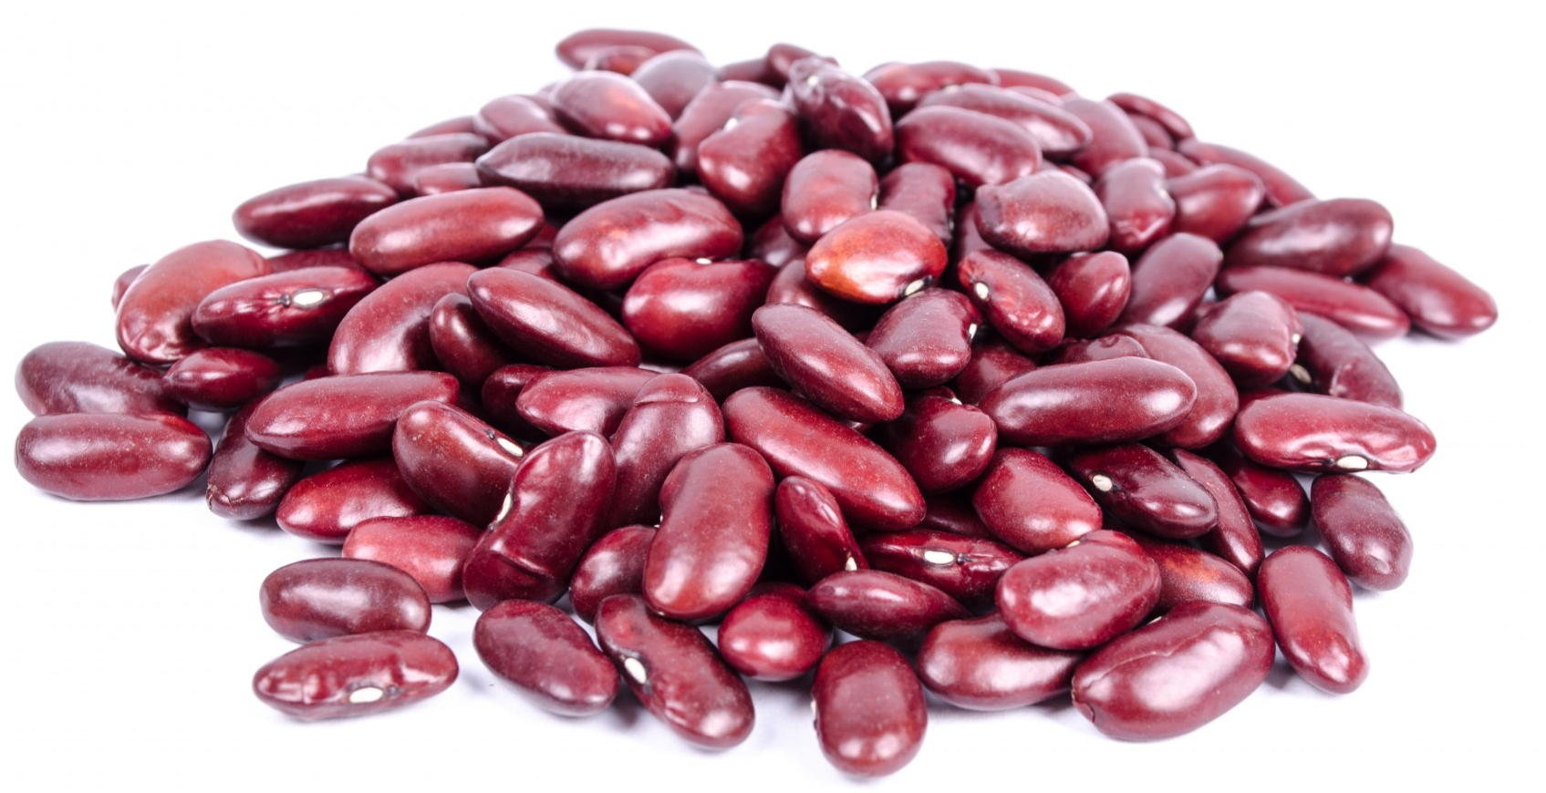
So these online adaptive systems will solve all my problems, right?
Technology learning curve
Alignment of prerequisite topics and course topics requires expertise and time.
Will students have the same ‘Question #5’?
Requires a shift in thinking about how to reference homework, and how students get help.
How do you use the data to support just-in-time remediation?
With more technology tools, how do you integrate them?

Slide 18
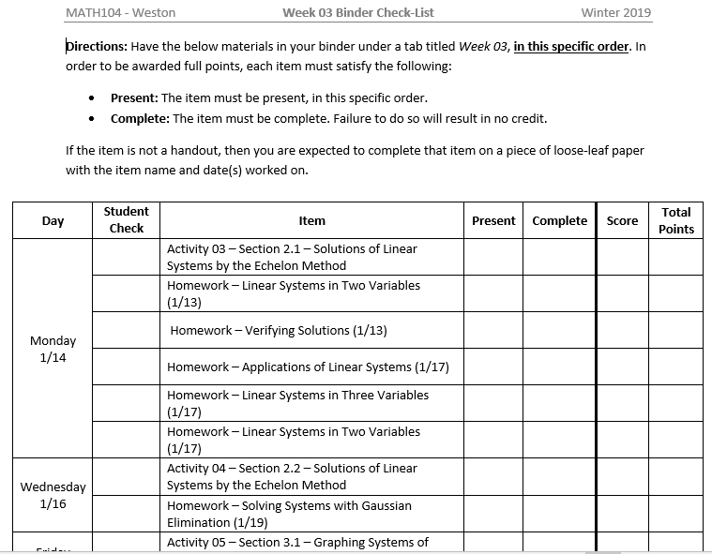
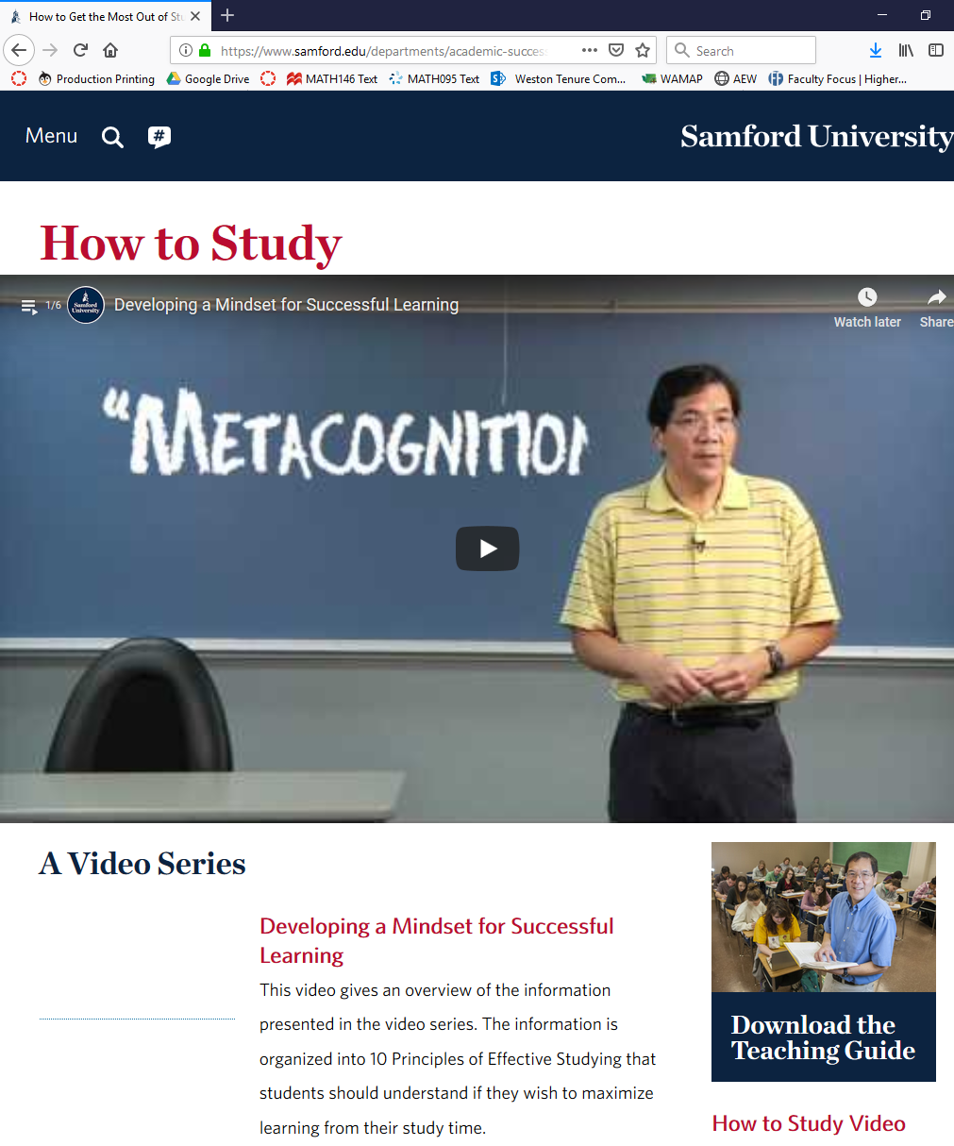
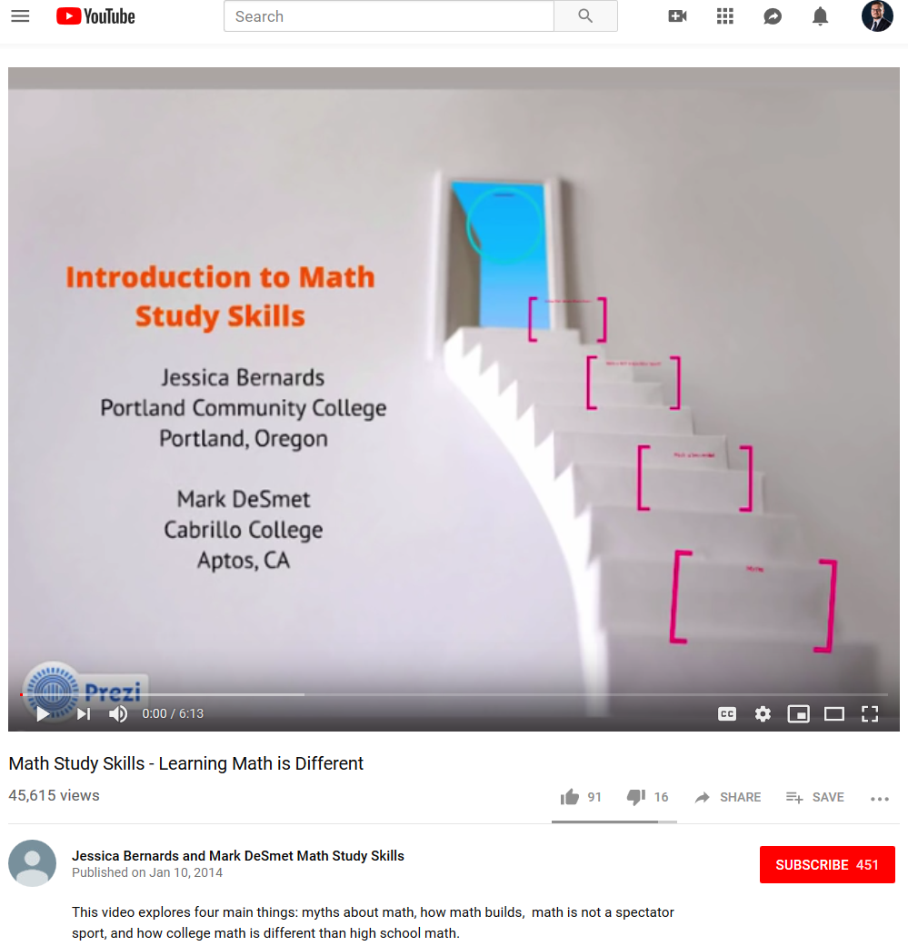
What have you done to address success skills?
Join Group B for an activity on success skills.
Time Management
Organization
Growth Mindset
Social Belonging and Community
Utilizing Resources
Integrating Understanding
Notes:
Along with everyone else in higher education we are learning how to integrate success skills into our courses. To be clear here are a few success skills we have identified and are trying to help our students develop; organization, metacognition, growth mindset, communication skills, and how to study. We have used a variety of methods to help students develop these skills, ranging from binder checklists, using freely available resources like Samford University’s video series How to Study and PCC’s Introduction to Math Study Skills, students creating study schedules and reflecting on how they are managing their time, and a variety of other methods.
What have you done to help students develop success skills?

Slide 19
Course Supports?
Catch-all for any in-class or online activities that are meant to support the course material.
Time to address student needs based on listening to their concerns and data from online adaptive system to address difficult prerequisite topics and course topics.
More time on difficult course material.
Additional review time.

Slide 20
How is Spring term going so far?

Slide 21
Who is enrolled in these courses?
Could have enrolled in MATH105/103/111
(STEM Algebra - MATH090/095
ALEKS >=45 TRMATH100)
Self-selection
non-STEM Algebra
MATH092/096
Business
or
STEM Major
Support Courses
MATH104/102/110
“Bubble” students
ALEKS Score of 36-45

Slide 22
Spring 2019 Enrollment
Student Group | 102 Total (2 sections) |  | 110 Total (2 sections) |  | 104 Total (1 section) |  | Total
Self-selection | 13 | 27.7% | 6 | 12.5% | 4 | 22.2% | 23 | 20.4%
Business or STEM Major | 14 | 29.8% | 24 | 50.0% | 9 | 50.0% | 47 | 41.6%
"Bubble" students | 20 | 42.6% | 18 | 37.5% | 5 | 27.8% | 43 | 38.1%
All students | 47 | 100% | 48 | 100% | 18 | 100% | 113 | 100%

Slide 23
What do students think of the courses so far?

Slide 24
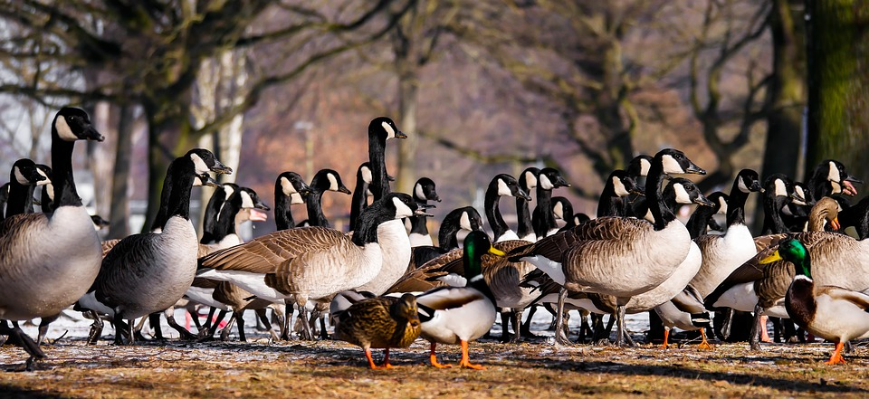
So an activity, huh?

Slide 25
Activity Directions
Activity A
Directions: Form a group of 2-3 people. The first person to sit down should distribute the Alignment Activity. The second person to sit down should start the activity by reading it aloud and get everyone to answer the questions on this page.
Activity B
Directions: Open envelope I and follow the directions in there.

Slide 26
Lessons Learned

Slide 27
Prerequisite content should be directly aligned to course content.
It may not be necessary to cover the entirety of the pre-college math course that students would have traditionally be placed in based on placement score.
We have focused on just those prerequisite topics that are necessary for the course topics.

Slide 28
Our model depends on faculty having varied skillsets.
Use Canvas and other online systems
Understand alignment of prerequisite material and course material
Support students in developing success skills
Student data collection and utilization

Slide 29
Are faculty and staff on board?
Training opportunities for faculty
Top-down? Bottom-up? Canned course?
Clear lines of communication with stakeholders across campus
Support from stakeholders across campus

Slide 30
Corequisite Support courses are a new format that uses credits in a new way.
Create a narrative around Corequisite Support courses that the college can understand.
The credit hour constrains how these courses are structured.
Connect to other regional colleges to share best practices.

Slide 31
No magic beans!

Slide 32
Next steps
Continue to improve these courses by refining alignment documents, active learning methods, success skill activities, and collecting and using data effectively.
Change to a 5 credit course with a 2-3 credit support course.
Based on student data in the online adaptive system we will decide whether a course needs a 2 or 3 credit support course.
Based on placement and success data we will decide if we need to change cutoff placement scores.

Slide 33
Thank you!

Slide 34
Credits
John Mitchell
Clark College Math Division Chair
jmitchell@clark.edu
Kate Cook
Pre-College Math Course Coordinator
kcook@clark.edu
Joan Zoellner
Course Program Specialist, Mathematics
joan.zoellner@austin.utexas.edu
Robert Weston
Corequisite Support Course Coordinator
rweston@clark.edu
Hannah Jackson
Corequisite Support Course Faculty
hjackson@clark.edu
Presentation template by SlidesCarnival

Slide 35
Presentation design
This presentation uses the following typographies and colors:
Titles: Roboto Slab
Body copy: Chivo
You can download the fonts on these pages:
https://www.fontsquirrel.com/fonts/roboto-slab
https://www.fontsquirrel.com/fonts/chivo
Lime #a6d683 / Clover #2ca388 / Fog #9eb3c2
You don’t need to keep this slide in your presentation. It’s only here to serve you as a design guide if you need to create new slides or download the fonts to edit the presentation in PowerPoint®

Slide 36
SlidesCarnival icons are editable shapes. This means that you can:
Resize them without losing quality.
Change fill color and opacity.
Change line color, width and style.
Isn’t that nice? :) Examples:

Slide 37
Some students will resist non-math assignments.
Is there a stated rationale for why students are completing non-math assignments?
Do you have student buy-in for non-math assignments?
Can you clearly link student success with your non-math assignments?

