Slide 1
ORMATYC What’s going on in AMATYC?
27 April 2019

Slide 2
Get Involved!
Supported Volunteer Positions
Project ACCCESS Coordinator
Review of applications begins April 30th
Email yours truly
Professional Development Coordinator
Accepting and Reviewing Applications now!
Northwest Region Representatives Needed
Student Math League Test Development Team
Student Research League Reviewer
Affiliate Delegate for annual conference

Slide 3
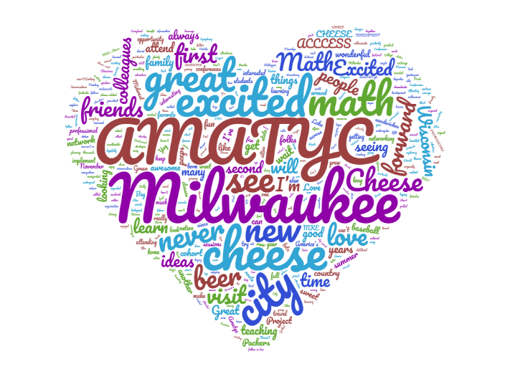
AMATYC Annual Conferences
2019: Milwaukee, Wisconsin
November 14th – 17th
Affiliate Scholarship
2020: Spokane, Washington
Northwest region!
November 12th – 15th
2021: Phoenix, Arizona
2022: Toronto, Ontario
2023: Omaha, Nebraska

Slide 4
AMATYC Membership
Individual Membership
$90 Per year
Benefits include assess to webinars, AMATYC Newsletter and MathAMATYC Educator
Institutional Membership
$510 Per year
Benefits include one discounted annual conference registration, AMATYC Newsletter, MathAMATYC Educator, Student Math League registration, Student Research League registration

Slide 5
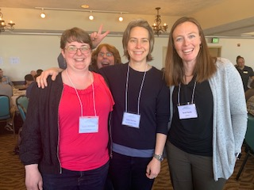
Professional Development Opportunities
Project ACCCESS
Fellowship for new faculty in first four years
Applications due May 15th
Webinars
Traveling Workshops

Slide 6
AMATYC Awards
2020 Mathematics Excellence Award
Nominations due by November 1, 2019
Wanda Garner Presidential Student Scholarship
One student nomination per affiliate
Nominations due October 15th
The Leila and Simon Peskoff Award
Project ACCCESS Fellows eligible
Nominations due May 1st
The Margie Hobbs Award
Speaker at annual conference for the first time
Nominations due June 1

